Slide 1
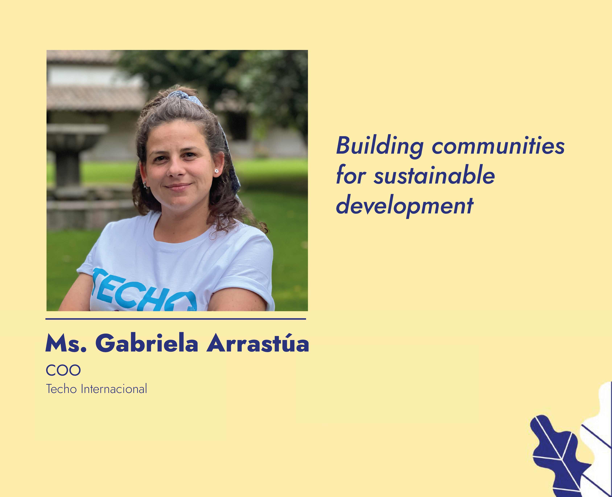

Slide 2






Incremental housing as an opportunity to build green and resilient communities, the experience of Latin America and the Caribbean
05.11.2024 | 09:00
Multipurpose room 05
Training event | 180 minutes

Slide 3



AT TECHO,
WE DREAM OF A FUTURE WHERE NO ONE HAS TO LIVE WITHOUT A ROOF.

Slide 4
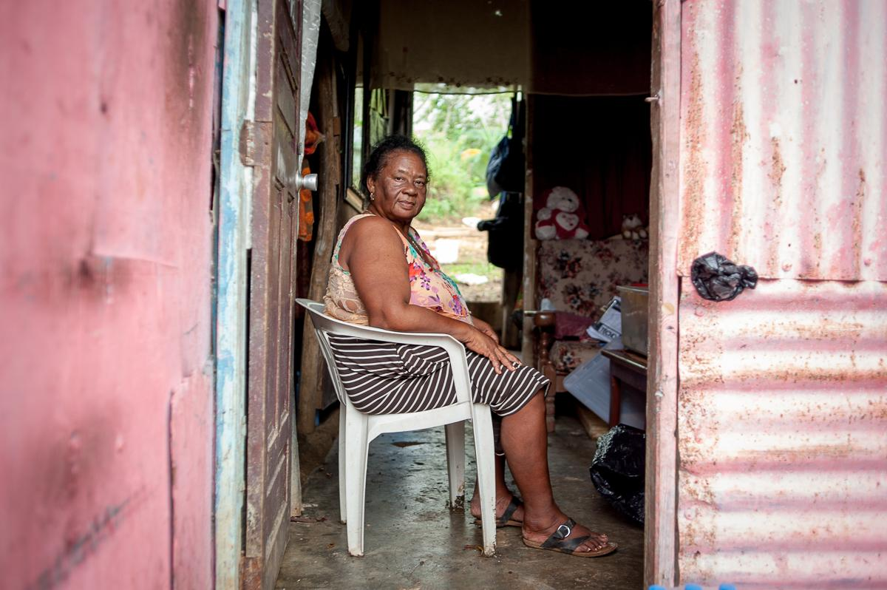
IN
LATIN AMERICA,
MORE THAN 201 MILLION
PEOPLE LIVE IN POVERTY
1 of 5 PEOPLE
in the region, live in informal settlements, with inadequate housing and a lack of at least one basic service like water or electricity.
* Source: ONU Hábitat(2020) y CEPAL (2022)

Slide 5
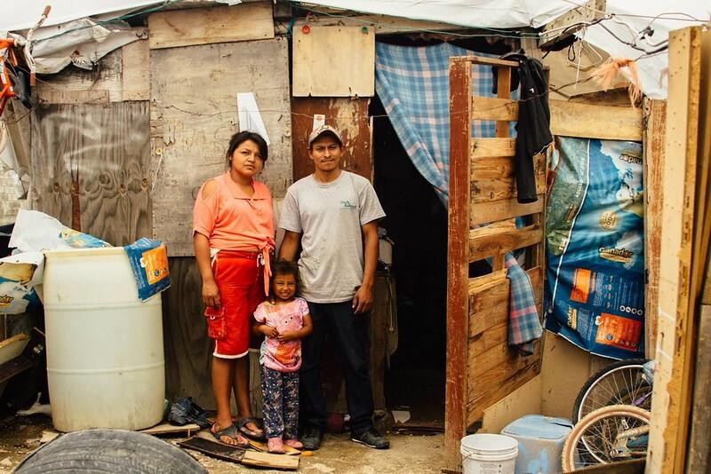



AÑO
How to ensure that housing solutions are adaptable to the evolving needs of these communities?

Slide 6
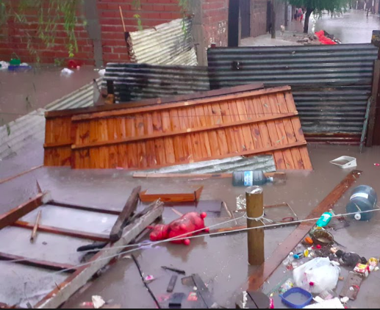
AÑO
How to integrate climate-conscious practices to mitigate the impact of environmental challenges?

Slide 7
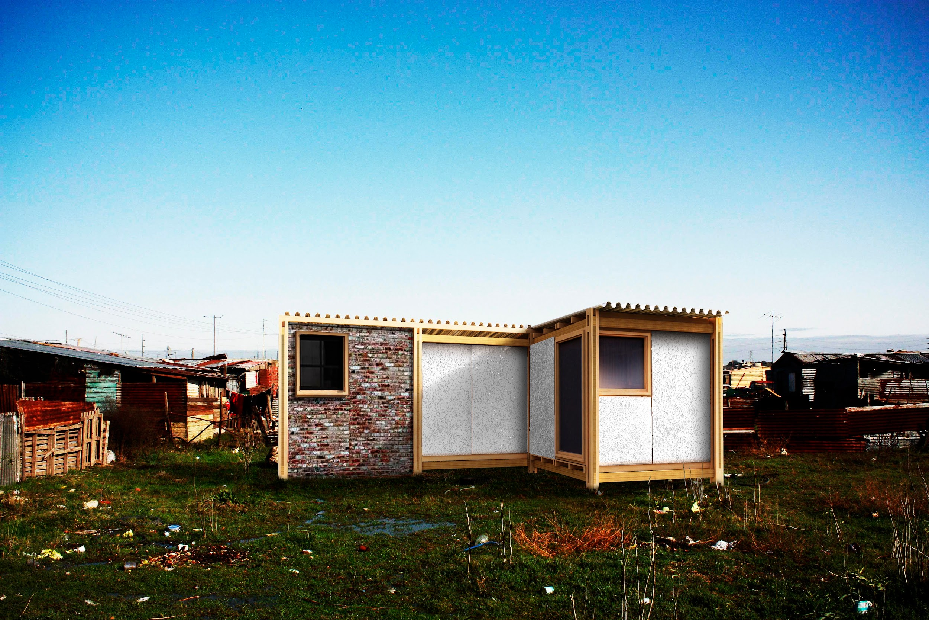
This is where the concept of incremental housing becomes essential

Slide 8
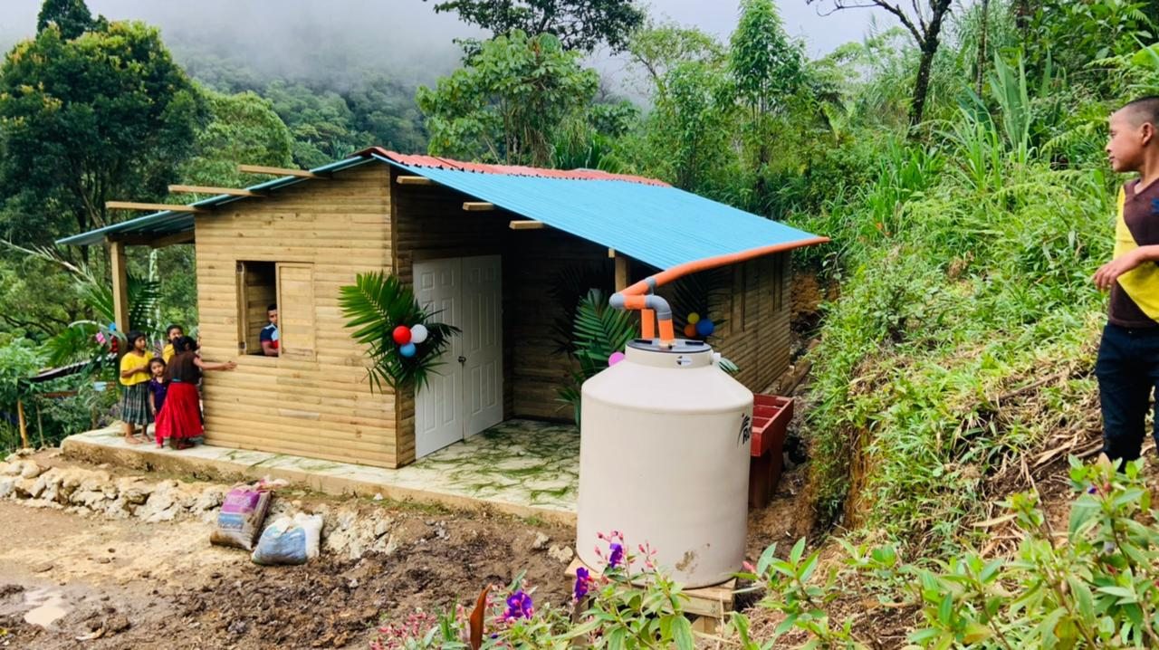
It provides the flexibility for households to upgrade and expand their homes over time, while gradually integrating green and resilient elements.

Slide 9
AÑO
How do we do it in a sustainable way?

Slide 10
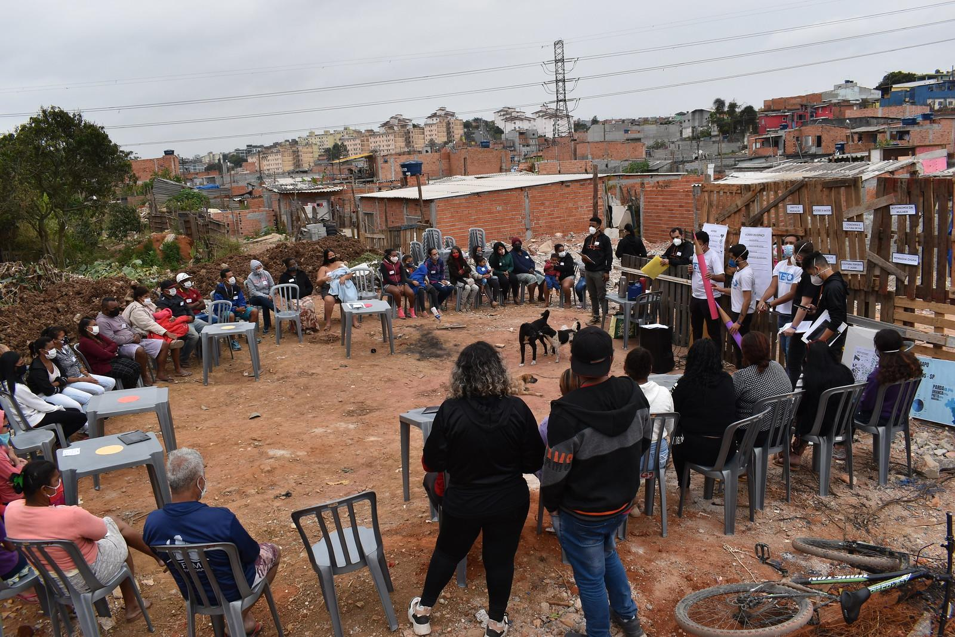
Capacity building in communities

Slide 11
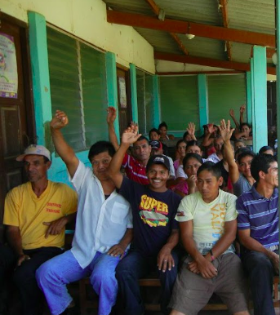

A participatory process, where the community is at the heart of designing, planning, and improving their homes over time

Slide 12
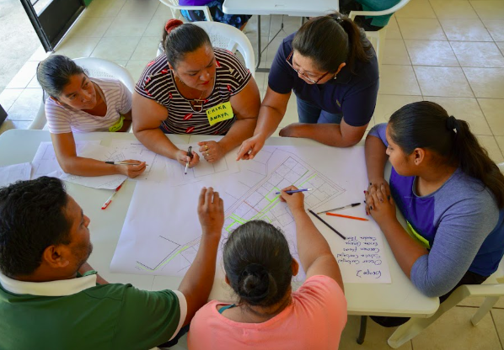
AÑO
Understanding the
problem together
We carry out participatory diagnoses and single-family surveys to identify the climate profile of the area and the risks the families face in their slums.
We also acknowledge the main challenges that families encounter when building and improving their homes.
The results of this diagnosis are then shared and analyzed with the community.

Slide 13
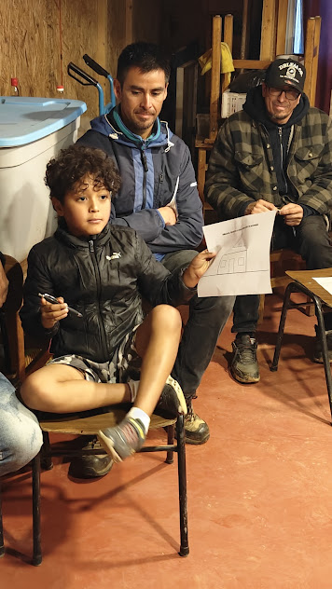
AÑO
Co-creating solutions: The answers is in the communities.
Local community leaders and volunteers work alongside facilitating workshops that empower families to actively participate in designing and improving their homes. This ensures that the solutions are tailored to their realities, respecting their cultural and social dynamics, while gradually integrating green technologies such as solar panels or rainwater harvesting systems.
The proposed solutions are implemented with the same community, promoting organizational processes, ensuring that people acquire knowledge about the cycle of a project, from planning to evaluation.
Also, the people share they knowledge with their neighbors and collaborate with each other to improve their houses.

Slide 14
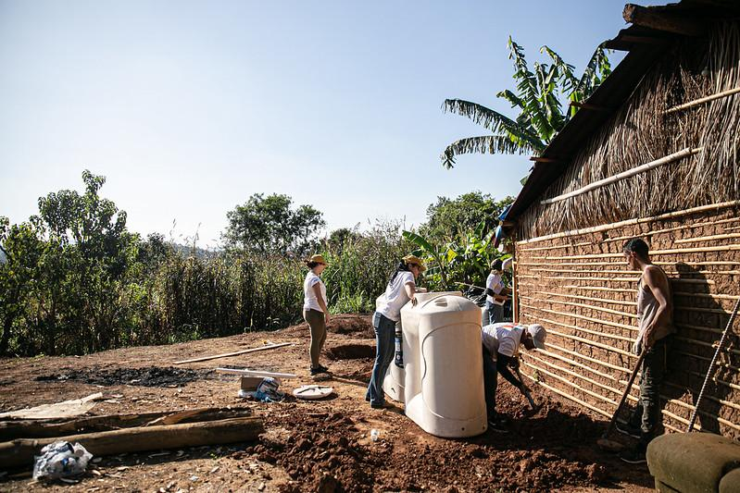
AÑO
Partnerships for long-term Impact
Collaboration is key. We work with local governments, international organizations, and private sector partners to access resources, scale projects, and ensure the long-term sustainability of the housing solutions.
The ROOH campaign brings together stakeholders to fund and promote housing models that are both affordable and resilient, but it also connects the community with other actors who provide new technologies for risk management.

Slide 15
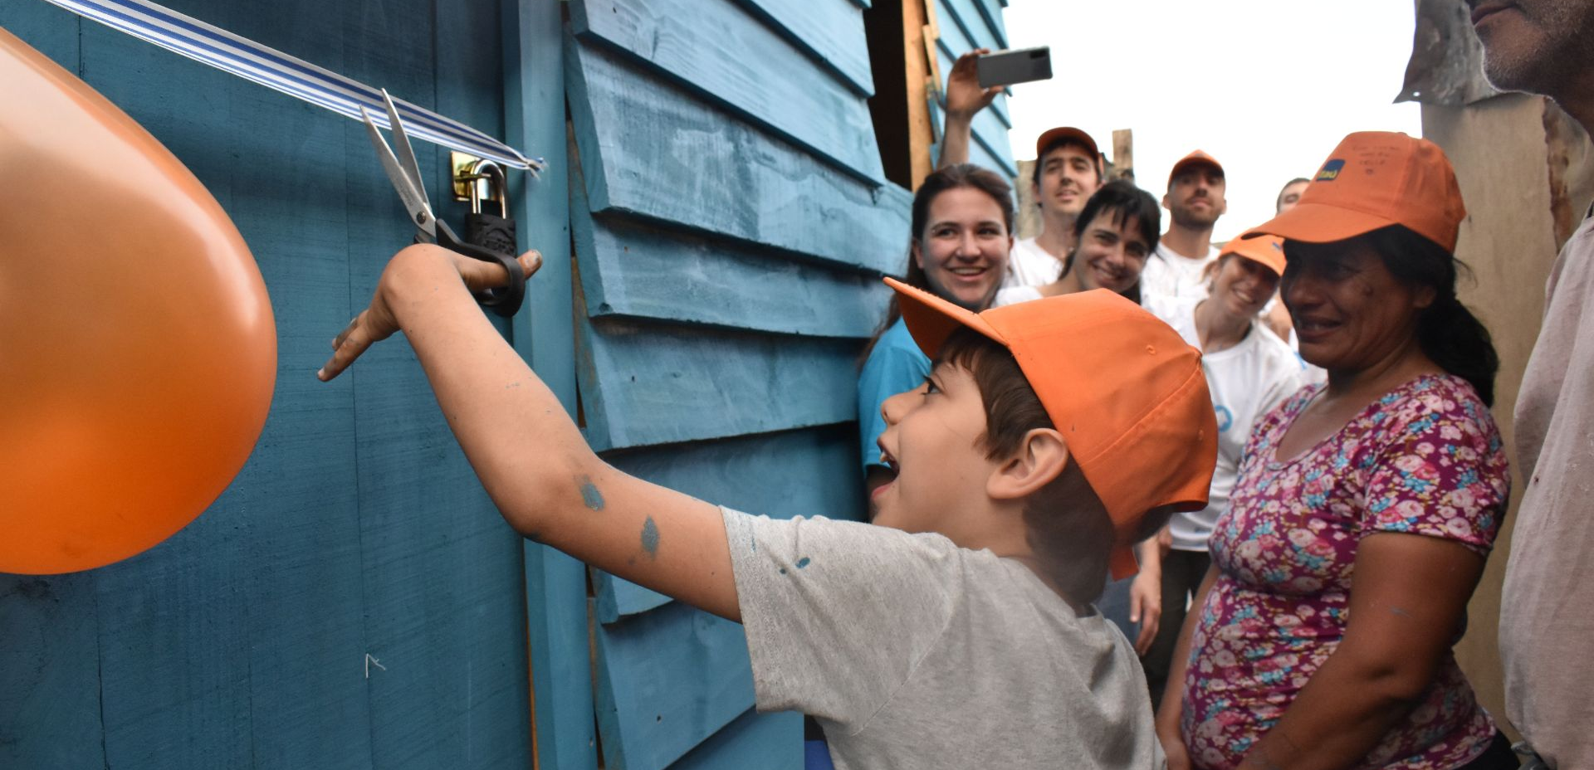
Incremental housing is more than just an economic solution—it’s a pathway to building resilient, empowered communities that are capable of leading their own development.
We need to invest in community-driven, resilient housing solutions that can adapt to the challenges of our changing world.
Let’s harness the power of collaboration to ensure that every person has the opportunity to live in a home that is not only safe but sustainable.

Slide 16


Gracias/
Thank You/
Obrigada.
Gabriela Arrastúa
COO
TECHO
gabriela.arrastua@techo.org
@techo_org / techo.org

