Slide 1
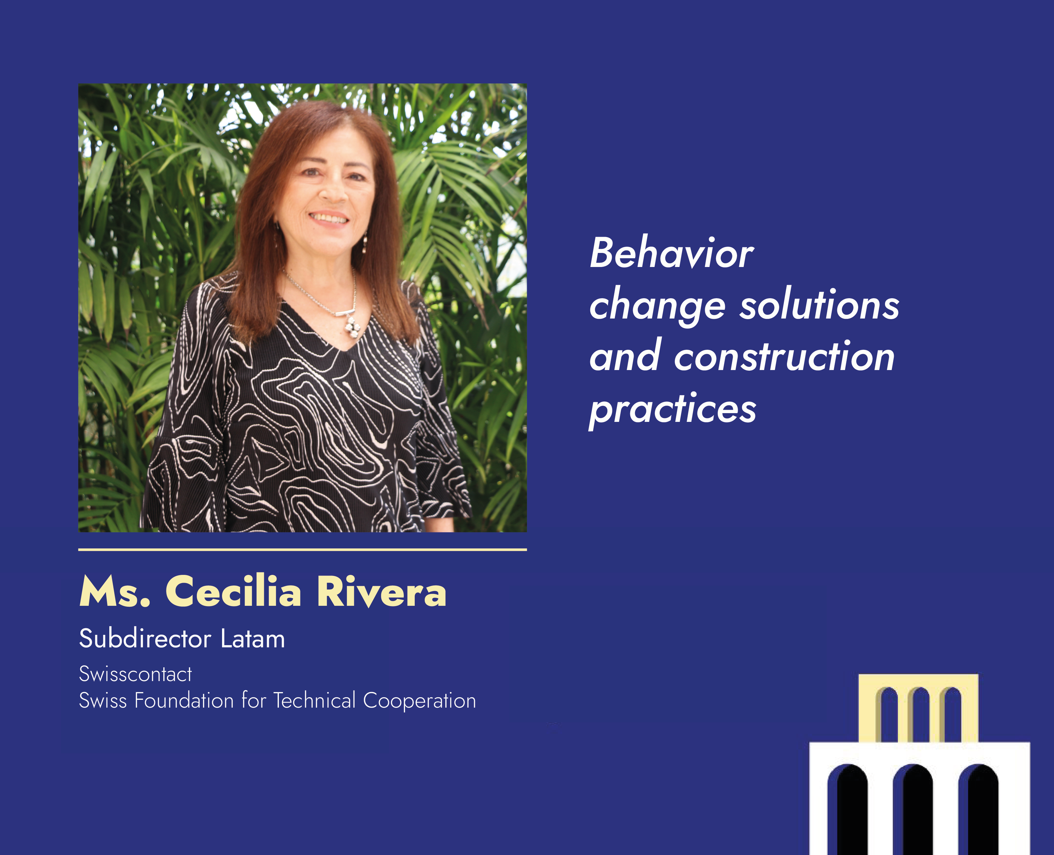

Slide 2
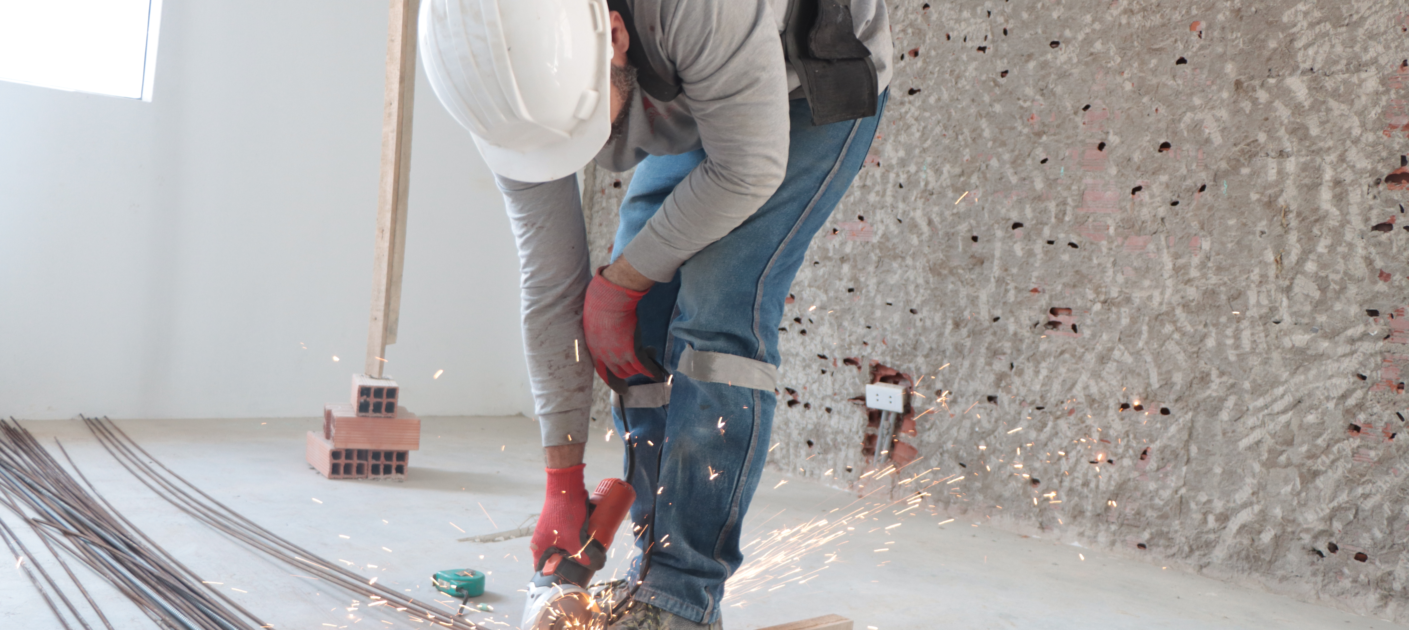


BEHAVIOUR CHANGE SOLUTIONS
& CONSTRUCTION PRACTICES
Financed by
Executed by
Notes:
I will share this experience, in the context of the VIPRO project, implemented in Peru by Swisscontact, and funded by the Hilti Foundation

Slide 3
Progressive housing
Householders
The sequential or progressive informal building process, led directly by the householder, who hires a master builder.
Master Builder
Notes:
Let’s agree on a definition for progressive housing for the purpose of this presentation. In few words, we are talking about the sequential or progressive informal building process, led directly by the householder, who hires a master builder.

Slide 4
Around
70%
of the housing stock is developed in this way in Latin America.
It takes a period of
10 to 20
years.
Notes:
This path takes a period of 10 to 20 years. In regions as Latin America, around 70% of the housing stock is developed in this way.

Slide 5
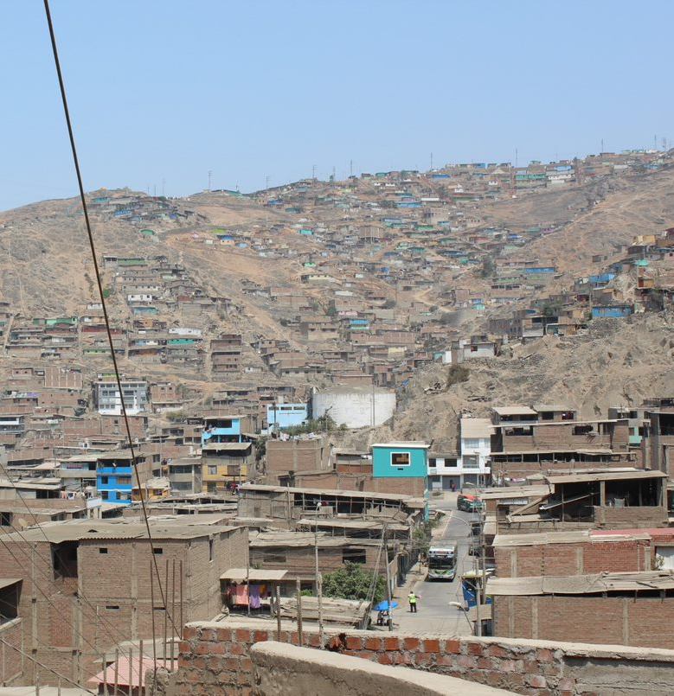
UNTRAINED
MASTER BUILDERS
Construction errors
Vulnerability
Habitability
Notes:
Progressive housing, developed by non-trained MBs, implies the existence of construction errors, leading to vulnerability and habitability issues.

Slide 6
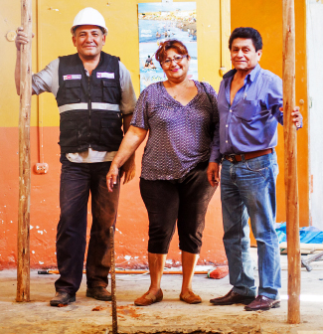
Families’ resilience.
Response to lack of solutions.
Growing need for housing.
Notes:
But it is also an expression of families’ resilience, a response to the lack of solutions provided by government and other actors to the growing need for housing.

Slide 7
Structural risks
Fails to reach
target group
Government
Subsidies
Householders
Notes:
Among the construction errors I mentioned before, structural ones are critical. For years, a solution has been expected from the public side, through subsidies for reinforcement or improvements.
However, experience shows that this kind of subsidies rarely meet the target group, at least at the needed scale.

Slide 8
Progressive investment
Expansions, refurbishments, improvements, etc.
10 to 20 years
USD 50K
Notes:
On the other hand, we know that throughout the mentioned 10 to 20 years, families intensively invest in their housing. Little by little, they earn money and then begin a new step of expansion or refurbishment.

Slide 9
Research questions
Is the issue of home reinforcement only a matter of public policy?
Is it possible to stimulate a private market for home improvement services?
Are families willing to pay for reinforcement services?
Notes:
In this context, our research questions were:
Is the issue of home reinforcement only a matter of public policy?
Is it possible to stimulate a private market for home improvement services?
Are families willing to pay for reinforcement services?

Slide 10
Families
83 % are aware of seismic risks.
68 % are interested in reinforcing their homes.
47 % are willing to pay for reinforcement services.
73 % trust and usually hire master builders.
Notes:
We have interesting progress, but would like to share with you our main challenges:
Costs of training (who pays)
Resistance to accept the role of MBs in reinforcement
How to scale such a model

Slide 11
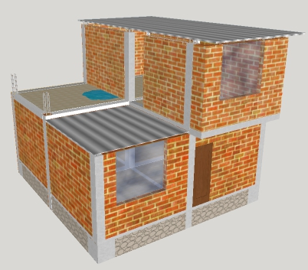
Roofs
Beams
Master builders trained during our inception phase are already selling their reinforcement services.
Columns
Walls
Notes:
Moreover, MB trained during our inception phase are already selling* their reinforcement services (columns, walls, beams and roofs)*, still at a low scale, but showing potential.
* Average price per intervention USD 700
*This is usually the priority order of intervention for reinforcement to prevent failure or collapse of the houses.

Slide 12
In other words, our approach to the matter shows the existence of an
embryonic market.
Notes:
In other words, our approach to the matter shows the existence of an embryonic market

Slide 13

MARKET INNOVATION
DEMAND
Reinforcement Solutions
ACTORS
ACTIVATION
FINANCE
ENABLERS
SUPPLY
Notes:
In other words, our approach to the matter shows the existence of an embryonic market

Slide 14
Supply
Supply + Demand
Demand
Diagnosis
tool
By master builder
Meeting points
For families and master builders
Families’ decision making
Analyse factors for change
Reinforcement solutions
Progressive
Low cost
Specific
Consumer behaviour change
Invest in reinforcement
Training for
master builders
Applying diagnosis and RS
Marketing strategy
For reinforcement services
Promote training
Materials
Companies
Government
Supply and demand connected
Supply developed
Demand activated
Notes:
, which can be dynamized through specific actions that constitute the core of our project:
* Develop a diagnosis tool that can be applied by trained MB
* Develop reinforcement solutions (low cost, focused on specific constructions errors, so families can conduct a progressive reinforcement process)
* Develop a training program (144 hours) for MB to acquire specific competencies for making a diagnosis and implementing reinforcement solutions.
* Promote MB’s training, supported by ecosystem actors (construction materials companies, government)
* Analyze families’ decision-making process, understand their incentives and factors that may generate changes in their decision making.
* Deploy a targeted consumer behaviour change strategy, aimed at families (so they start investing in reinforcement services).
* Deploy a marketing strategy to make visible the existence of reinforcement services.
* Develop mechanisms to ensure the encounter between the supply and demand side (one-stop shop, hardware stores, municipal offices…)

Slide 15
Main challenges
Costs of training.
Behavior change experiences.
More financial services for the segment.
How to scale the model.
Notes:
We have interesting progress, but would like to share with you our main challenges:
Costs of training (who pays)
Learn and find other experiences applying behavior change methods.
How to bring more finance services to the segment of progressive housing (particularly for improvements)
How to scale the model

Slide 16
Thank you.
Financed by
Executed by
Notes:
Let’s agree on a definition for progressive housing for the purpose of this presentation. In few words, we are talking about the sequential or progressive informal building process, led directly by the householder, who hires a master builder.

