Slide 1
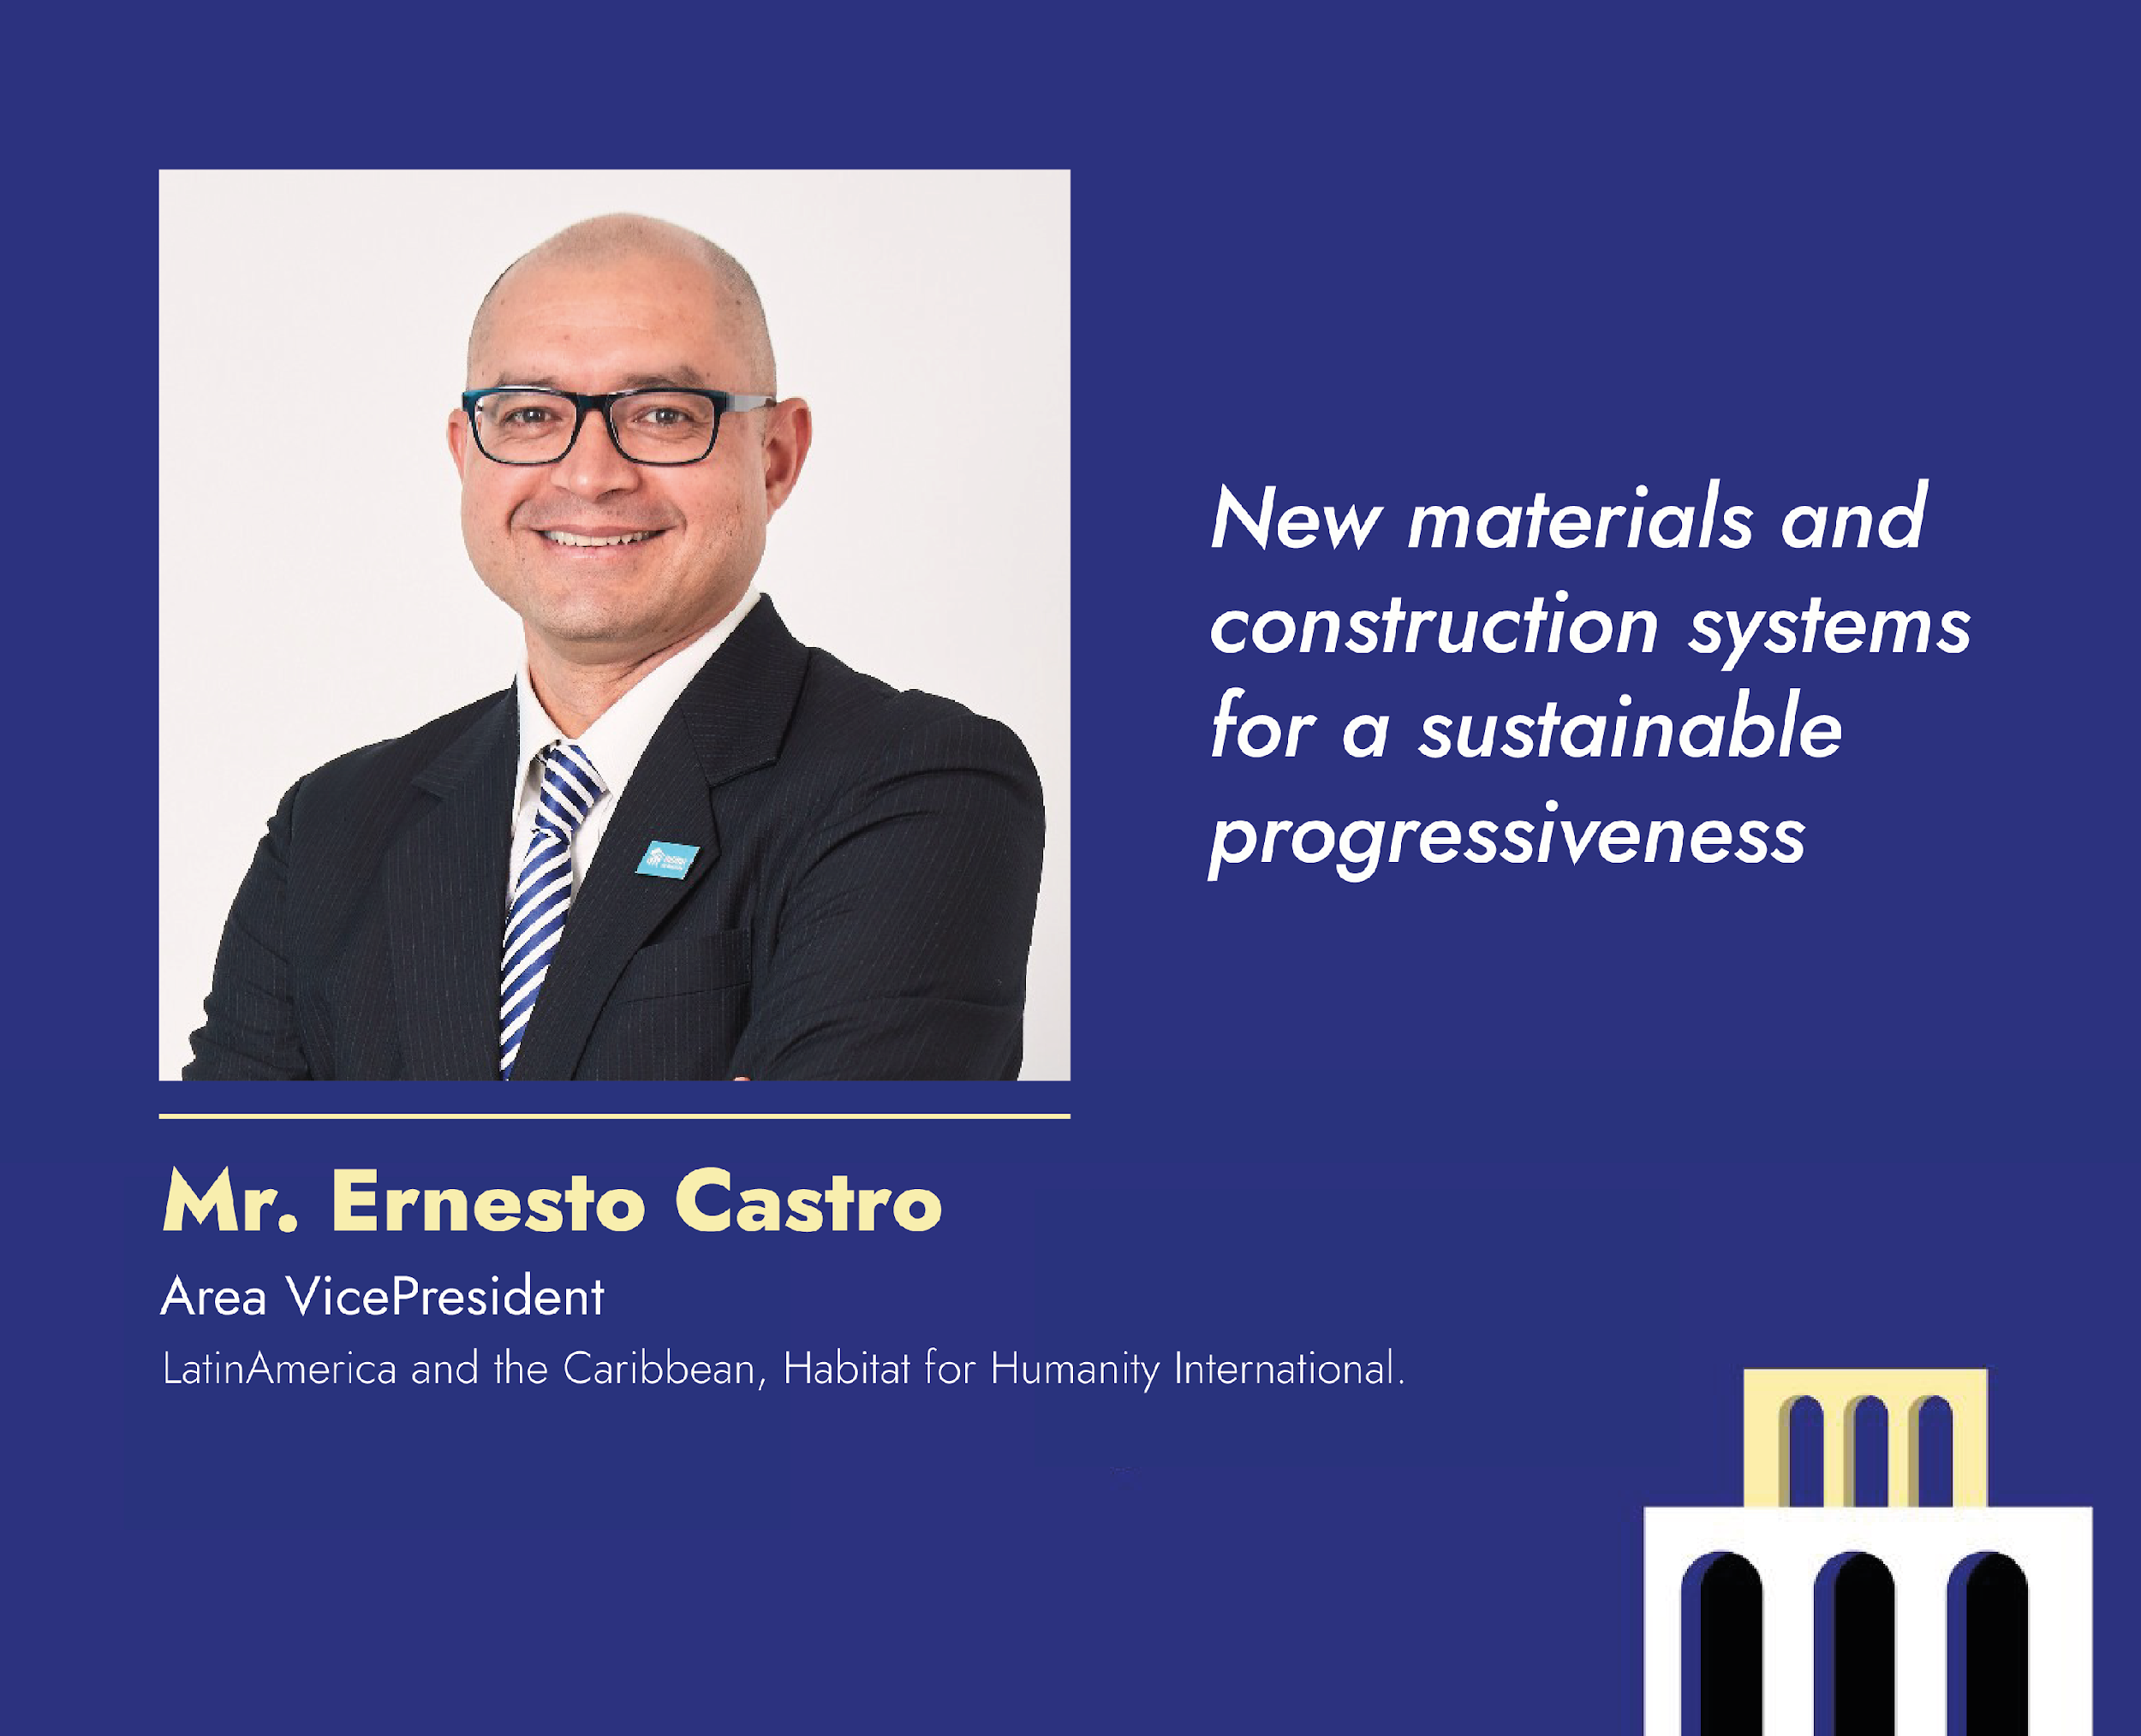

Slide 2

Incremental housing and innovative materials against climate change
LAC EXPERIENCE

Slide 3

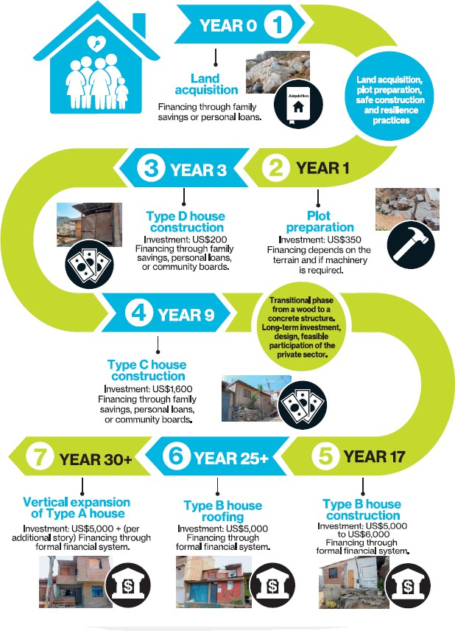

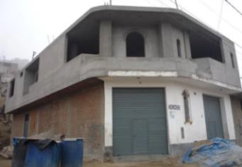
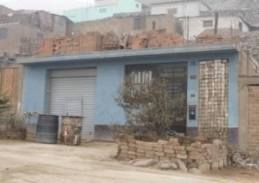
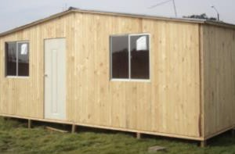
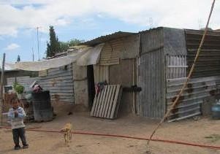
Incremental Housing Journey
Type A
Type B
Type C
Type D
Study: Housing at the BdP, TCIS Lima, Peru 2018

Slide 4
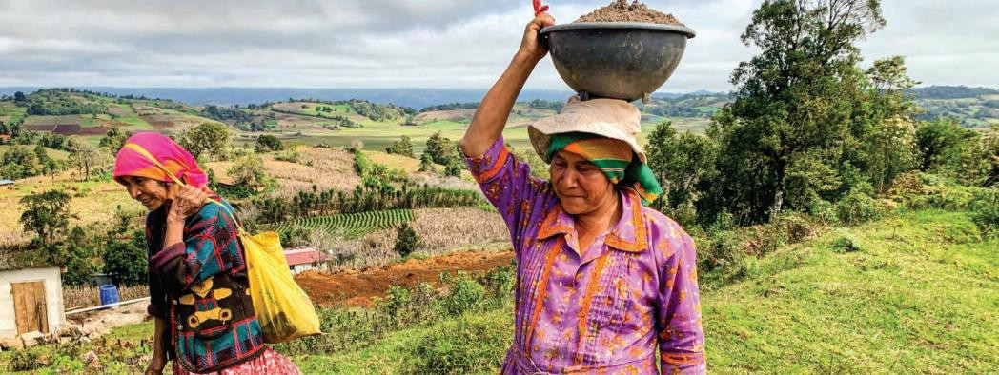











Central American Dry Corridor Study
Strengthening cultural roots, livelihoods, access to water through housing
HFHI LAC, Dry Corridor Study, 2021
Key Findings
Land tenure
Significant inequalities and gender disparity
~ 5 M indigenous people suffer from inequalities in
land tenure
80%
of basic grain-producing
families in the dry corridor live in poverty.
30%
of families live in
extreme poverty
20%
of the population
does not have access to safe water in their homes.
50%
Household income
covers less than 50%
of families’ expenses.
Employment deficit
Drains productive capacity of the countries Negative impact on the economy
Returning migrants have worse socioeconomic conditions than when they left and have difficulties reincorporating into the market
25-31%
5-13%
5% to 13% of
families practice open defecation.
of the Northern Triangle population has reliable access to water.

Slide 5


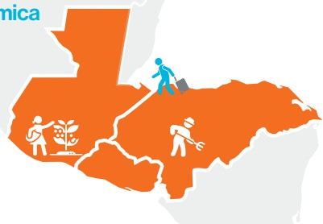






APPROACH
Projects focused on primary issues: habitability, access to basic services, affordability, and secure tenure.
1
Strengthening livelihoods and access to water
Promote affordable financing mechanisms for housing, productive housing and water and sanitation
3
Advocacy for public policies
2
HFHI LAC, Dry Corridor Study, 2021

Slide 6

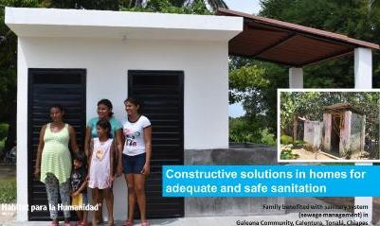




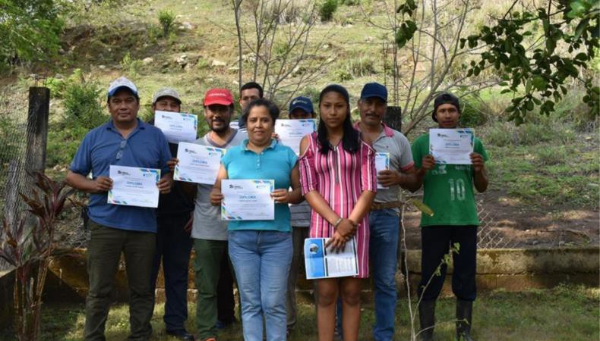


37
Mexico: progressive housing WASH
43
Gray water
treatment system
Water storage systems
91,458
Beneficiaries
105
146
Sanitation
systems
Training
Achieved project results
workshops
400
Household water
purification systems
57
ProWASH committees were formed

Slide 7
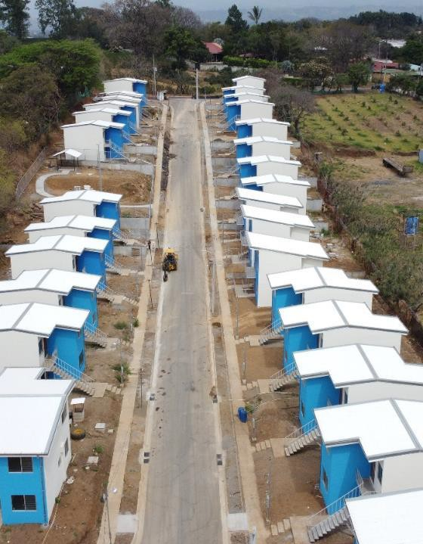






Innovative Materials
Resin8: Costa Rica, El Salvador, Dominican Rep.
90
EDGE
Certification
Tons of plastic used in 100 houses
810
Beneficiaries
112
Housing units
Housing for elderly and people with disabilities
50
Floors
Valle Azul Project, Costa Rica
VALLE AZUL - ECO-SUSTAINABLE HOMES, COSTA RICA

Slide 8
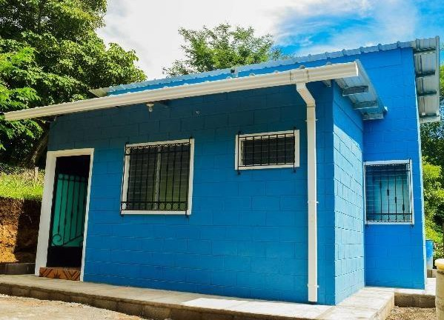




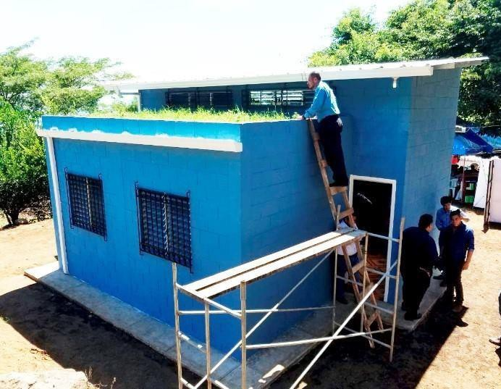




Bioclimatic house
El Salvador
Cross ventilation
Green roof technology
Bioclimatic housing reduce
temperatures in 2ºC
Green Building Council Award

Slide 9
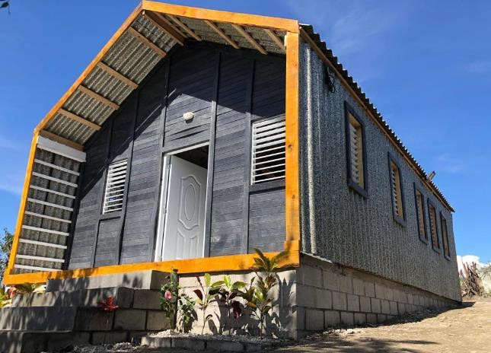
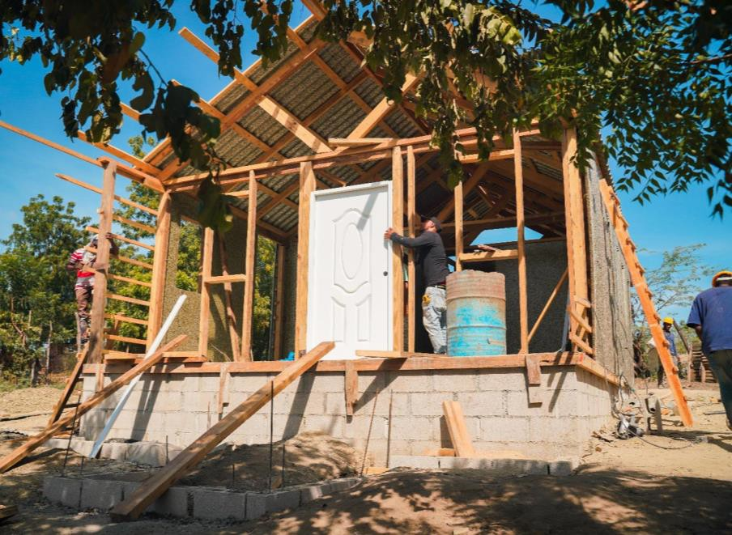
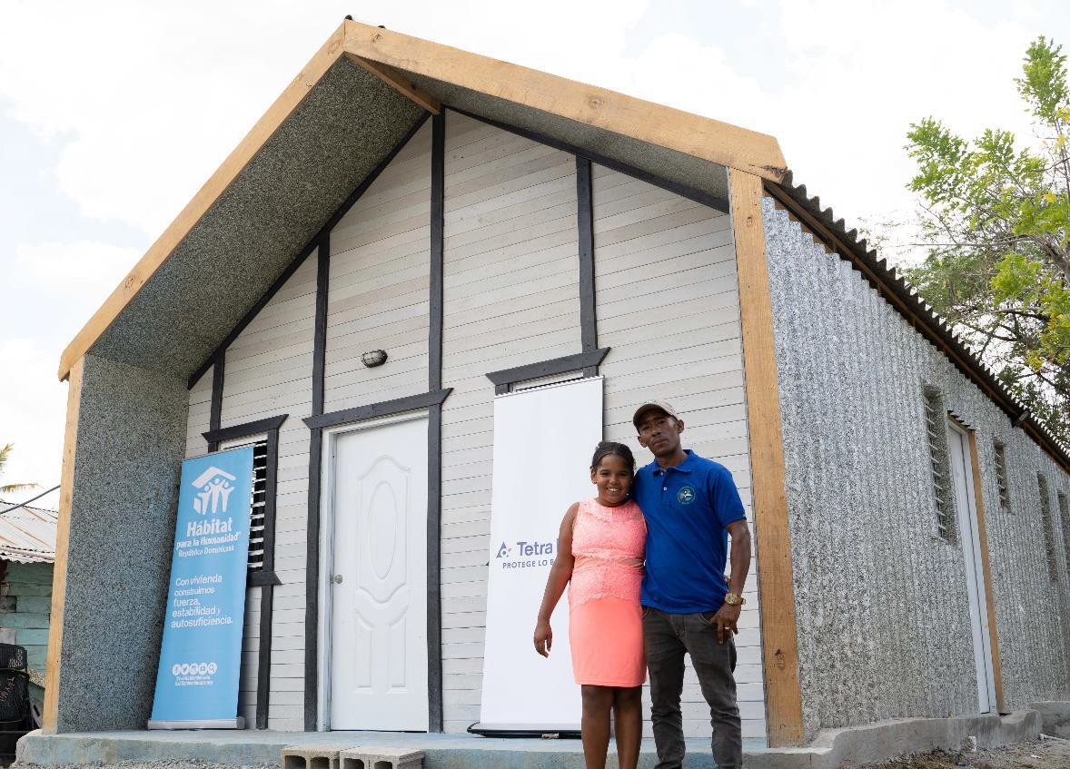
Tetra Pak
Dominican Republic
Concrete
13%
Roof and walls are covered
with polyaluminum sheets, of which up to 70% is derived from recycled Tetra Pak packaging.
Polyaluminium
50%
Wood
23%
Recycled plastic _{14%}

Slide 10


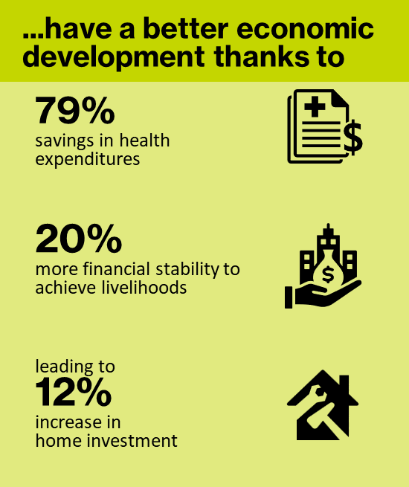
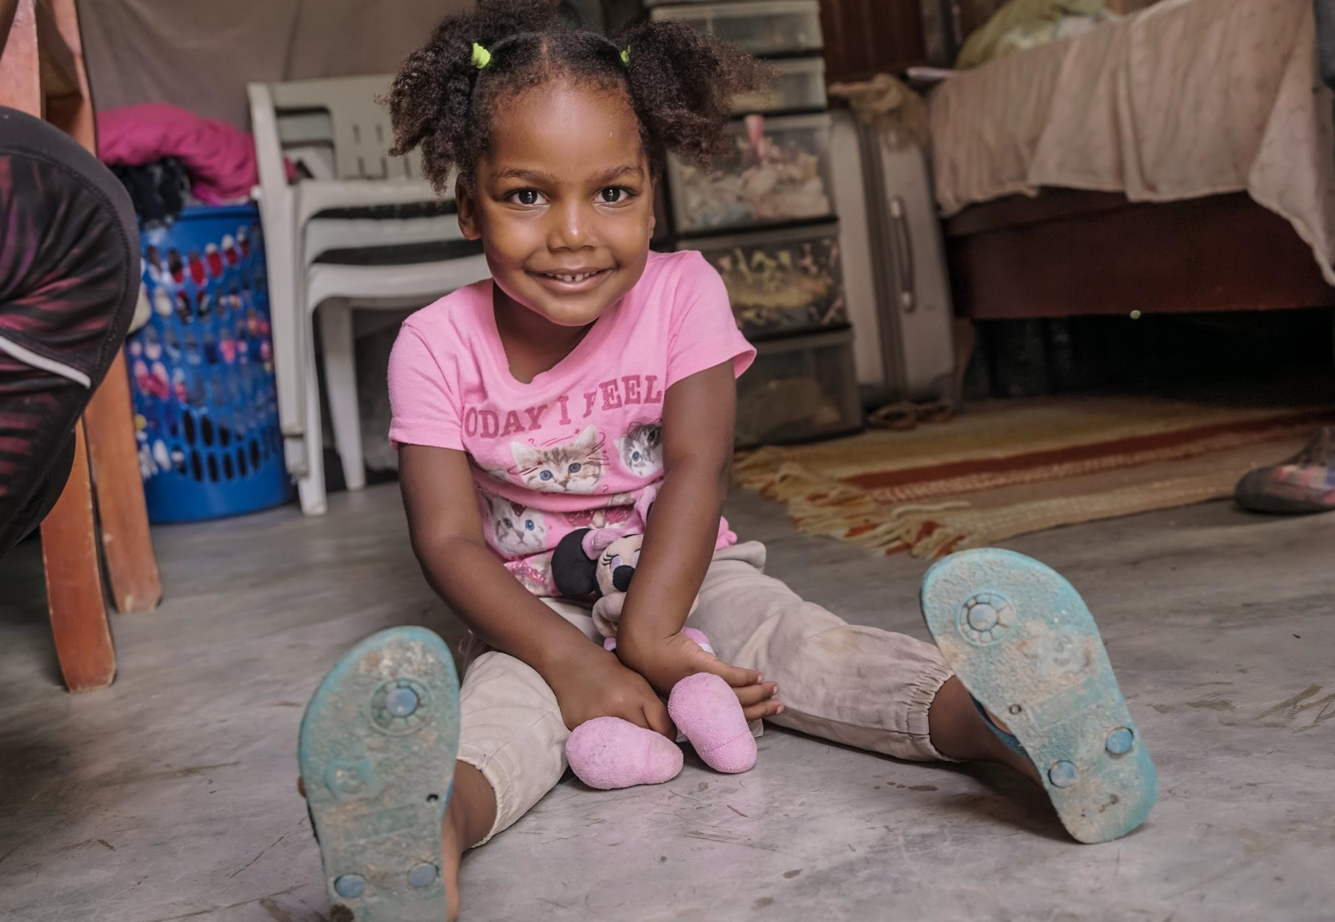

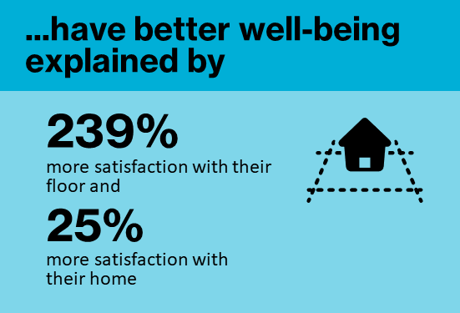
HFHI LAC – Impact Study in Dominican Rep, 2024

Slide 11
Thank you!

