Slide 1
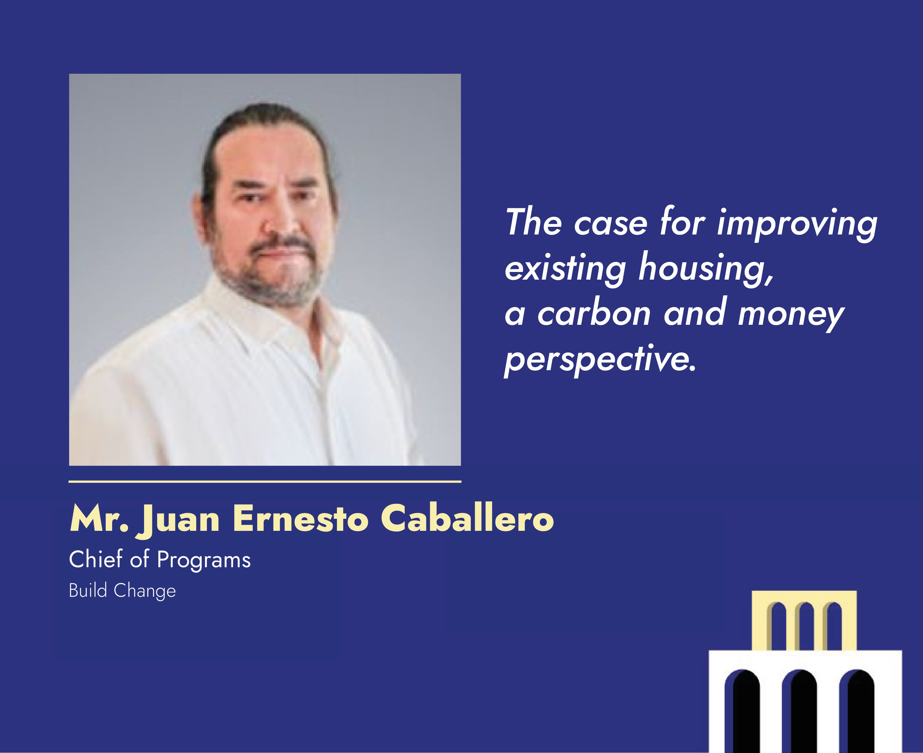

Slide 2
The Case For Improving Existing Housing
A carbon and cost perspective
World Urban Forum
05 November 2024

Slide 3
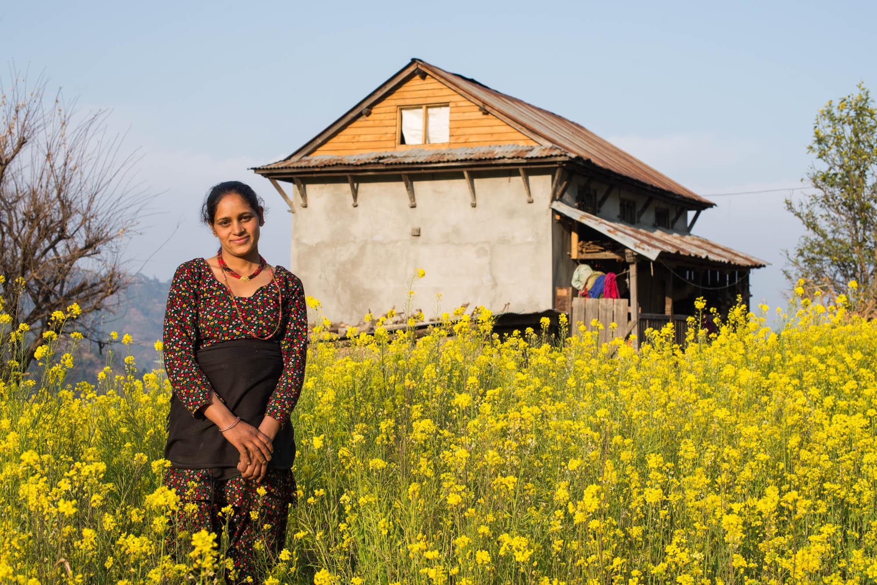
OUR VISION
Every
home
is disaster-
resilient.

Slide 4
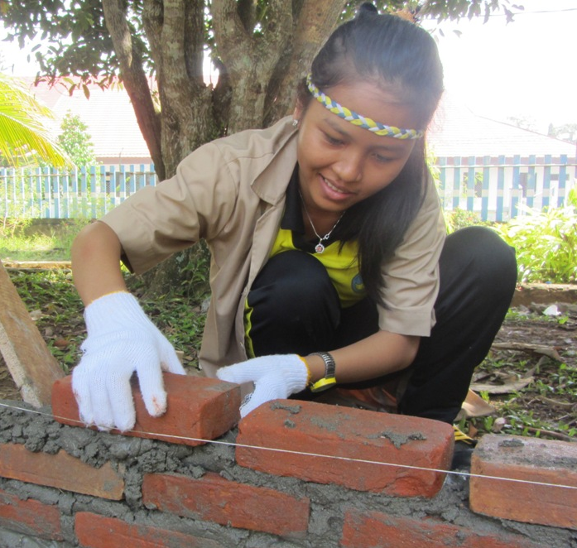
OUR MISSION
To greatly reduce deaths, injuries and economic losses caused by housing and school collapses due to earthquakes, and extreme weather disasters and fires.

Slide 5
RESILIENT HOUSING IS A CLIMATE ADAPTATION SOLUTION

Slide 6
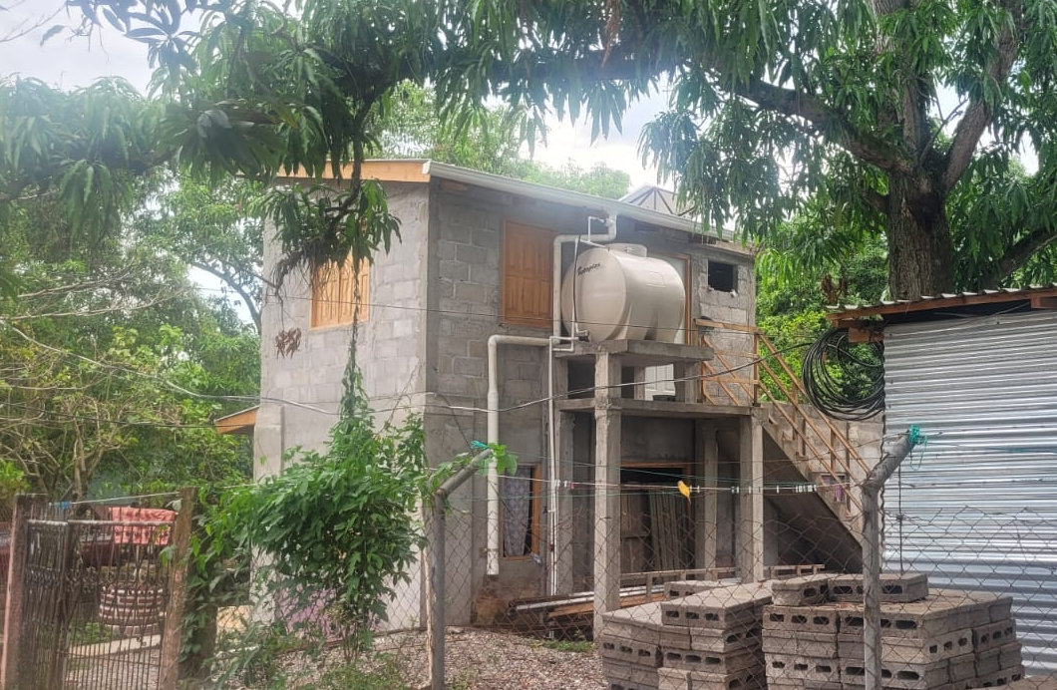
CLIMATE ADAPTATION
Program for resilient second stories in the Sula Valley, Honduras

Slide 7
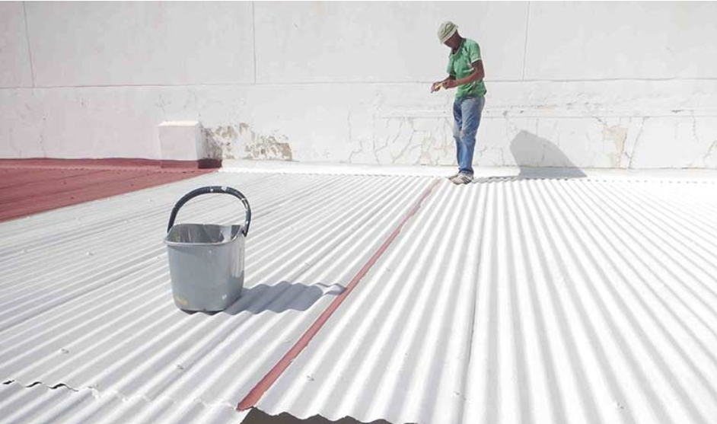
CLIMATE ADAPTATION
Microfinance loans for extreme heat adaptation in Indonesia

Slide 8
RESILIENT HOUSING IS ALSO A CLIMATE MITIGATION
SOLUTION

Slide 9
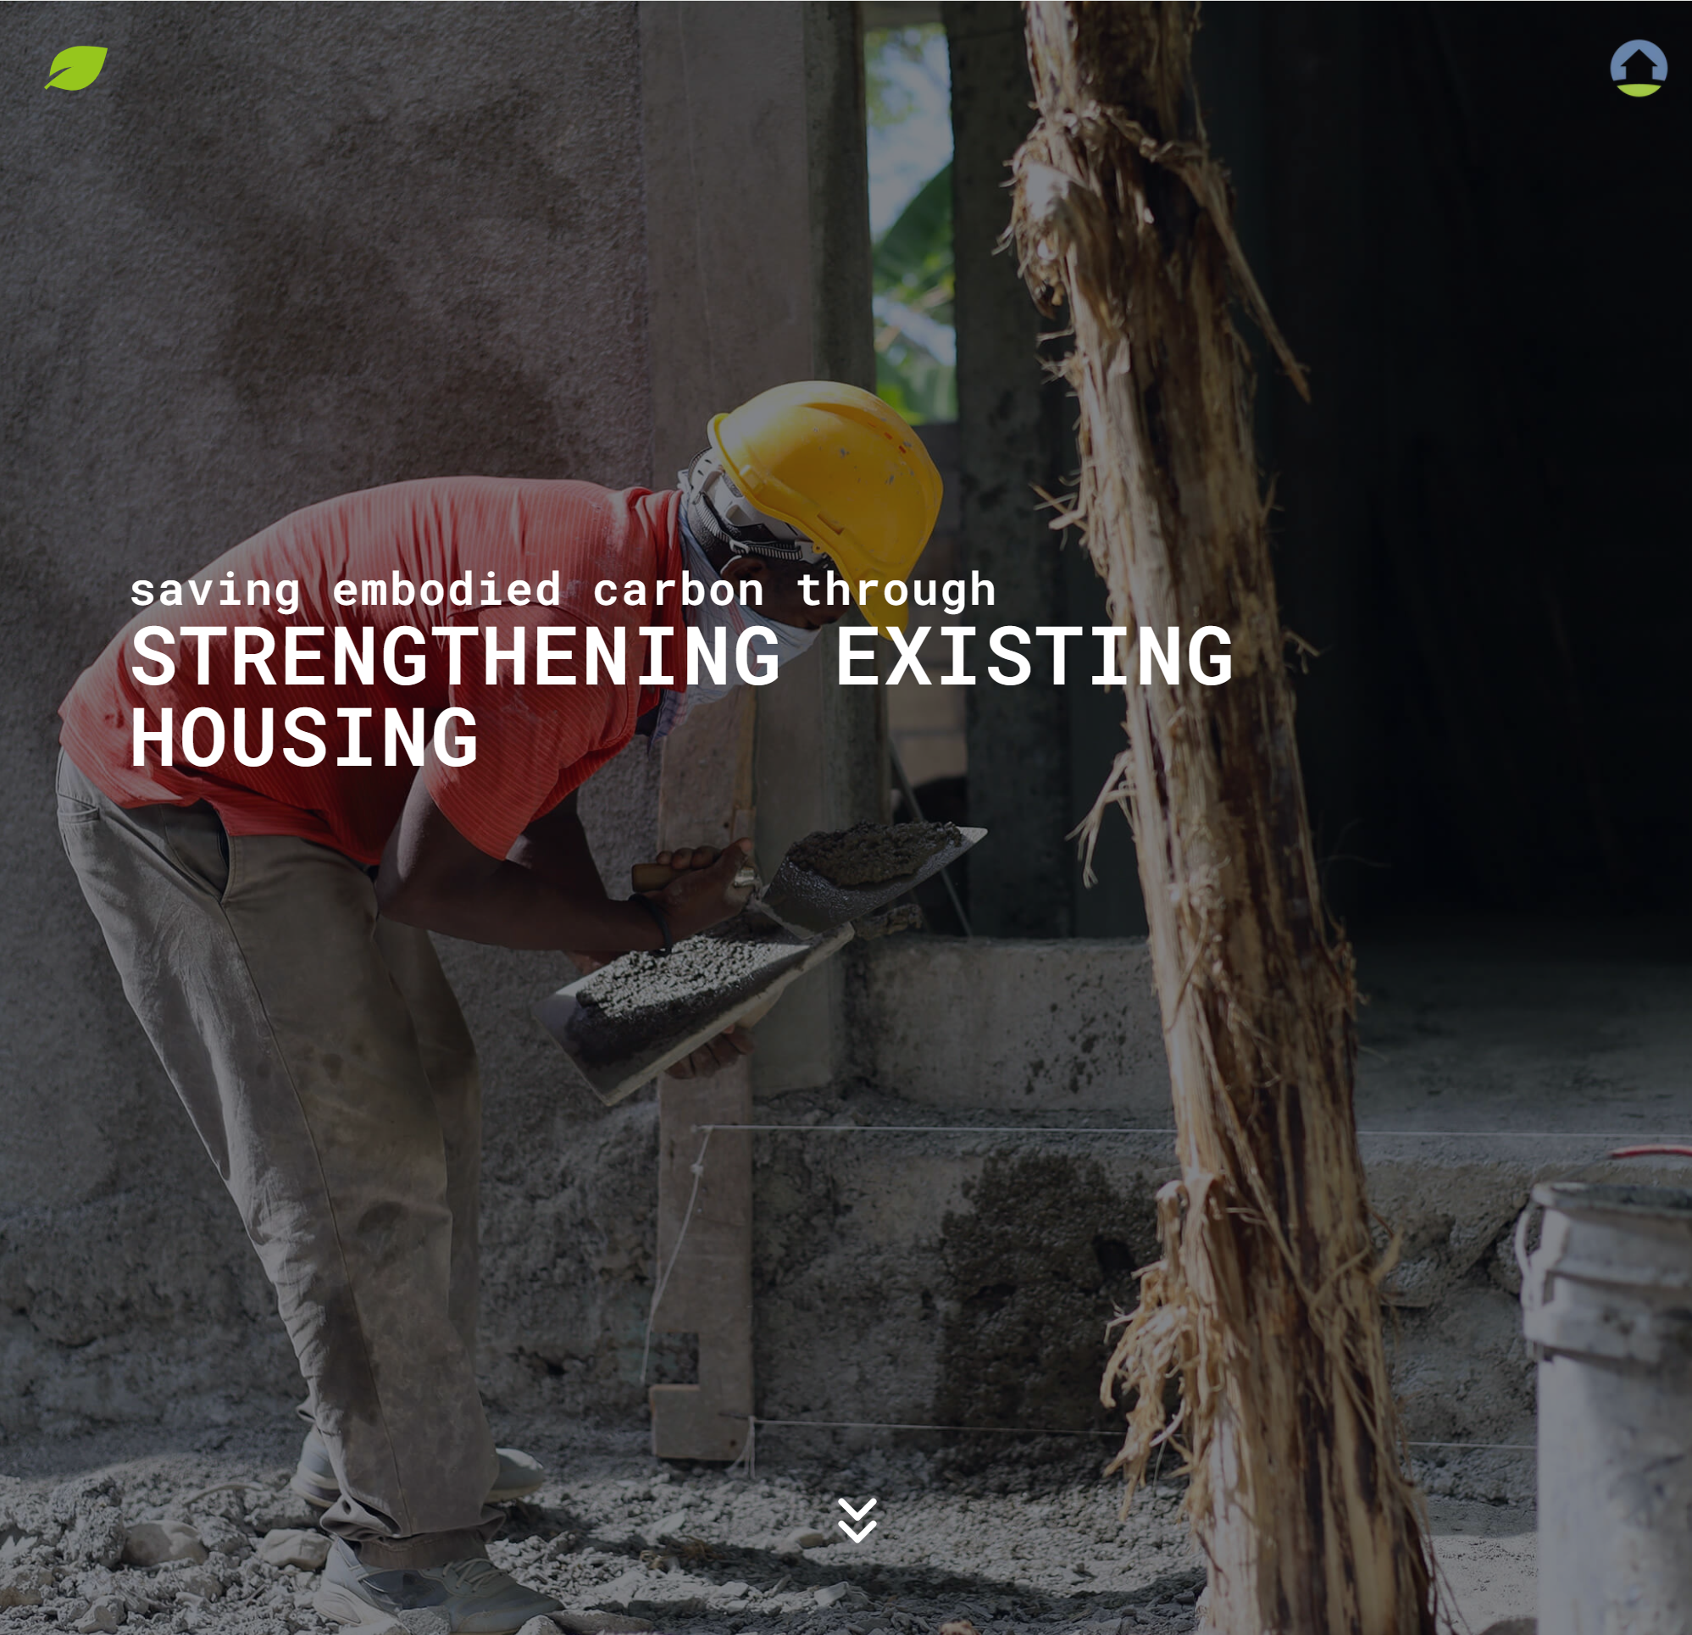
CLIMATE MITIGATION
Build Change estimates there’s an opportunity to save 4.8 gigatons of CO2 emissions while addressing the more than 268 million inadequate houses globally.

Slide 10
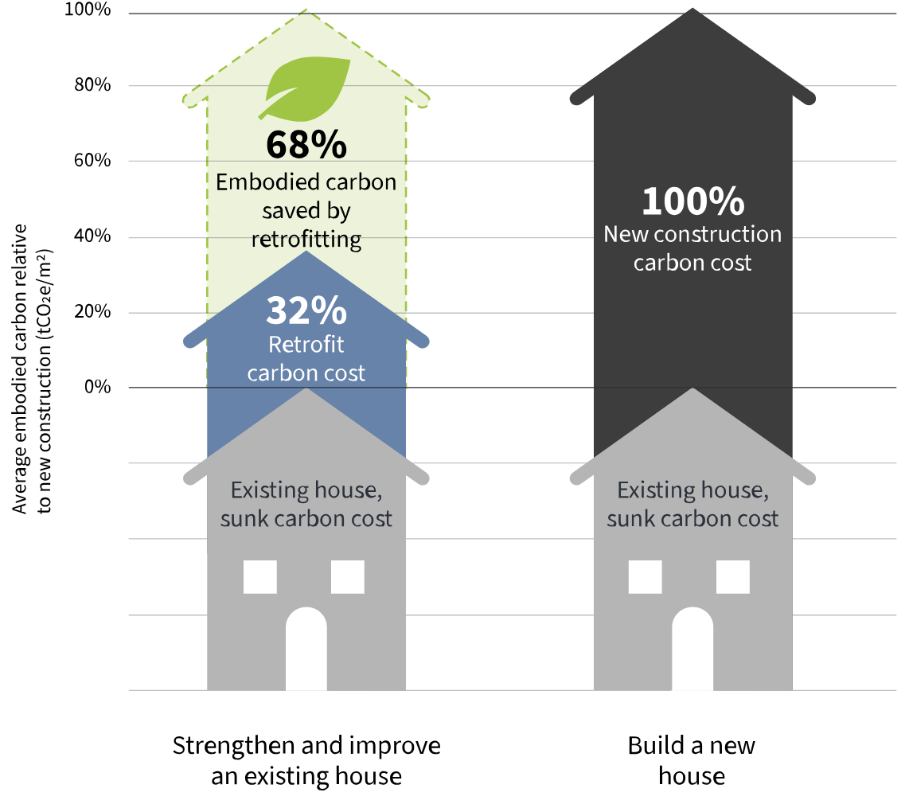
CLIMATE MITIGATION
Each home improved saves over two-thirds of the embodied carbon generated by an equivalent new house.

Slide 11

CLIMATE MITIGATION
Download the full report Saving Embodied Carbon through Strengthening Existing Housing here!
Emissions savings for a preventative upgrade are
61% higher
than a post-disaster upgrade
It is more carbon-efficient to improve an existing house before a disaster than after.

Slide 12
The Cost of Improving
Existing Housing
Recommendations for Investments in Housing Resilience from an Analysis of Global Project Data
Notes:
Following the implementation and development of hundreds of home improvement designs from Asia, the Caribbean, Latin America and the Pacific, data was compiled and analyzed to understand the cost of home improvement and how spending is allocated across different kinds of interventions, specifically Structural condition repairs, Habitability upgrades, Disaster mitigation measures and Finishings and growth.
Cost data was compared across different building typologies, hazards, contexts, and structural performance objectives, and overall costs compared with the relative cost of new construction.
The data highlights many reasons why preventatively improving existing housing for health and safety before the next disaster is not only crucial but a smart, cost-effective investment, including compared to the alternative of building new housing.
One of the common barriers to homeowners, governments, funders and others who could invest in improving existing housing is a lack of information or misunderstanding about the associated costs.
This home improvement cost study was undertaken by Build Change in order to share key information and trends about the costs of improving existing housing to make it more resilient.
It is based on detailed design and cost information representing 1,484 home improvement designs in fourteen countries over an eight-year period (2013–2020), across a range of contexts and programs in Asia, the Pacific, Latin America and the Caribbean.

Slide 13
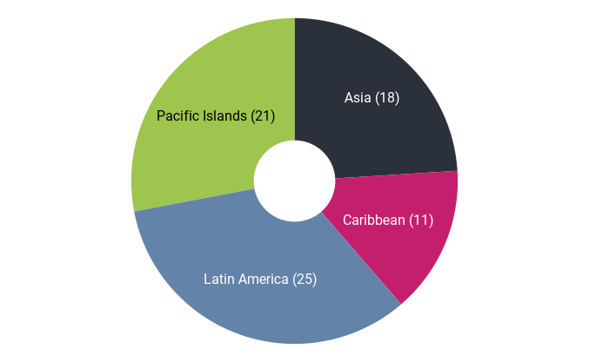
Dataset
TABLE 1 Dataset by Region
LOCATION | NO. OF SAMPLE DESIGNS REPRESENTED | NO. OF DESIGN GROUPS
ASIA | 321 | 18
CARIBBEAN | 940 | 11
LATIN AMERICA | 202 | 25
PACIFIC ISLANDS | 21 | 21
TOTAL | 1,484 | 75
FIGURE 1 Number of Design Groups by Region
13
Notes:
Build Change drew upon a dataset of 1,484 sample designs from Asia, the Caribbean, Latin America, and the Pacific Islands. Approximately 300 designs were determined to be representative of all 1,484 and were grouped into 75 different design groups (Table 1). The dataset covers fourteen different countries across four regions: Indonesia, Nepal and the Philippines (Asia); The Commonwealth of Dominica, Haiti and Sint Maarten (Caribbean); Colombia, Guatemala and Mexico (Latin America); and Cook Islands, Samoa, Solomon Islands, Tonga and Vanuatu (Pacific Islands) (Figure 1). Representative examples in each design group were averaged across the group, and each design group was weighted equally across the dataset.
The cost data analyzed as part of this study includes only the direct construction costs of home improvements, including structural, non-structural and other construction costs, like demolition, when applicable. Non-construction direct costs, such as technical assistance, permit fees, etc., or indirect costs, such as relocation costs or financing costs are not included.
The data for this study was collected over eight years (2013–2020), and all costs were adjusted for inflation to 2020 (see Appendix 1).
Design groups consisted of sample designs that shared key characteristics such as location, building typology, performance target, hazards considered, and context. A brief explanation of these key characteristics is provided below. Sample designs within the same design group were averaged to get an overall representative set of costs for each group.

Slide 14

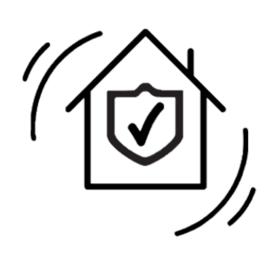


Cost Categories
Structural condition repairs
Habitability improvements
Disaster mitigation measures
Finishing and growth
14
Notes:
Structural condition repairs - Items that require repair or replacement due to damage from past events, insects, deterioration, etc
Habitability improvements – Items that are required to meet basic health and safety standards or accessibility requirements
Disaster Mitigation measures – Items that are specifically added to mitigate risk of building collapse or other life-threatening hazards in the event of an earthquake or windstorm.
Finishing and growth - Items desired by the homeowner or occupant, often forward-looking in their use of the house. – like additions or expansions

Slide 15
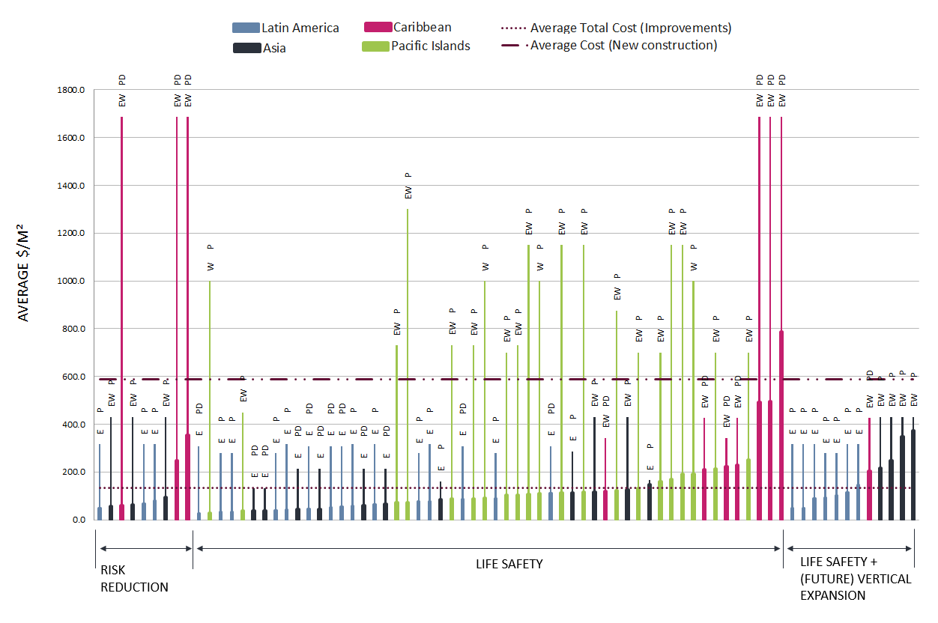
Improving existing housing is a cost-effective strategy to reduce the qualitative housing deficit, especially when compared to new construction.
FIGURE 2 Total Cost of Improvements and New Construction by Design Group
15
Notes:
On average across the data analyzed, the cost of improving existing housing was only 23% of the average cost of building new housing of the same size in the same locations. The average cost of improvements for all design groups was $133/m² and the average total cost of new construction for all design groups was $588/m² (see Figure 2).

Slide 16
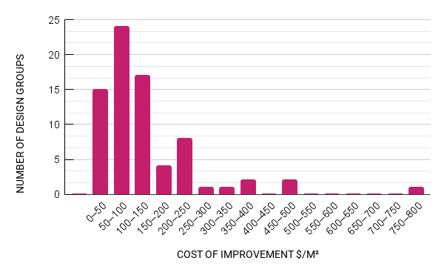
Improving existing housing is a cost-effective strategy to reduce the qualitative housing deficit, especially when compared to new construction.
TABLE 3 Improvement Cost by Performance Target Compared to New Construction Cost
IMPROVEMENT PERFORMANCE TARGET | IMPROVEMENT COST $/M² | IMPROVEMENT COST AS A % OF NEW CONSTRUCTION COST
RISK REDUCTION | $119 | 15%
LIFE SAFETY | $128 | 21%
LIFE SAFETY + (FUTURE) VERTICAL EXPANSION | $169 | 47% 35% (FUTURE EXPANSION) 69% (EXPANSION INCLUDED)
FIGURE 3 Frequency Distribution of Total Cost of Improvement by Design Group
Investments in improving existing housing should be prioritized as a cost-effective means to address the gap in the global supply of adequate housing as well as to combat increasing threats due to climate change.
16
Notes:
Looking at the frequency distribution of the costs by design group (Figure 3), 39 out of the 75 design groups had a total cost below $100/m². Additionally, although there were some outlier groups, for 90% of the design groups the total cost of improvements was below $250/m².
When only design groups targeting Life-Safety performance are considered, improving existing housing is even more cost effective, costing on average 21% of the average cost of new construction (Table 3). In other words, constructing new housing is almost five times more expensive than improving existing housing for essentially an equivalent level of disaster resistance.

Slide 17
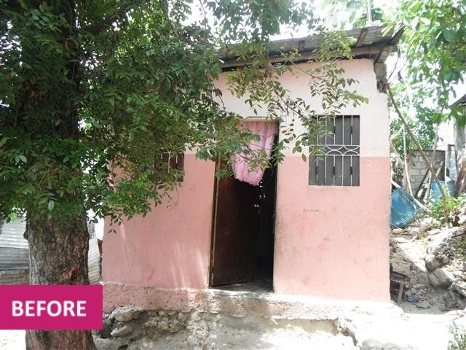
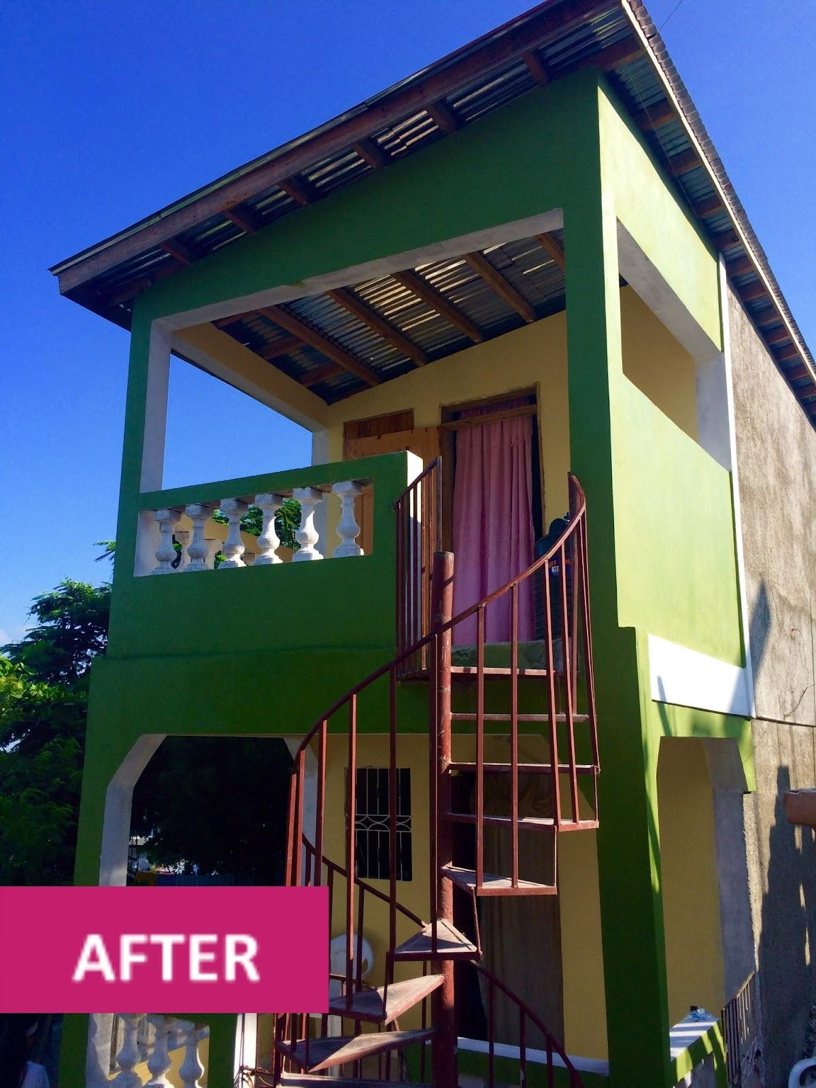
In many cases, improving existing housing can be further leveraged to safely densify housing and cost-effectively create new housing units.
TABLE 3 Improvement Cost by Performance Target Compared to New Construction Cost
IMPROVEMENT PERFORMANCE TARGET | IMPROVEMENT COST $/M² | IMPROVEMENT COST AS A % OF NEW CONSTRUCTION COST
RISK REDUCTION | $119 | 15%
LIFE SAFETY | $128 | 21%
LIFE SAFETY + (FUTURE) VERTICAL EXPANSION | $169 | 47% 35% (FUTURE EXPANSION) 69% (EXPANSION INCLUDED)
Investments in improving and expanding existing housing should be prioritized as a cost-effective means to support densification and address the gap in the global supply of adequate housing, particularly in urban areas.
17
Notes:
Overall, improvements that included upgrading the existing house to safely receive a future vertical expansion were on average 35% of the average cost of building a new house of the same size in the same locations (Table 3). These improvements may include work on the existing house such as replacing a lightweight roof with a slab roof that can support a future second level, or increasing the strength of the ground floor to account for increased lateral loads due to the future vertical expansion.
In cases where the house was improved on the ground floor and then a second floor was also added as part of the work, the average additional cost associated with preparing for and adding the new space to the existing one-story house (beyond the cost of just a Life-Safety improvement) was essentially equal to the cost of new construction for the same location. However, this does not account for the cost of land and site development that would likely need to be added to the cost of new construction, thereby making improvement plus expansion less expensive overall when compared to new development. There are also social and environmental benefits to safely densifying strategic urban areas instead of developing new sites, often outside of established communities.

Slide 18
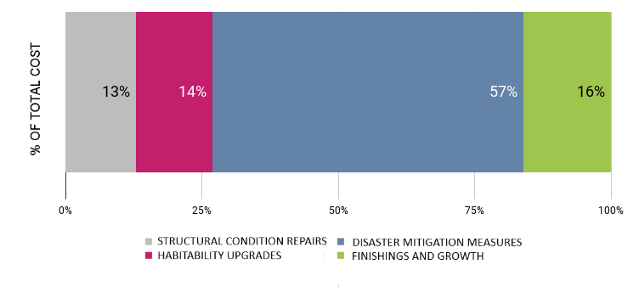
Home improvement investments address multiple challenges: Homes can be made more resistant to disasters, while supporting other goals linked to increased household resilience.
FIGURE 6 Average Cost of Improvements by Cost Category
There is demand from homeowners for interventions other than those solely required to mitigate disaster risk, and investments in these categories should be accounted for when increasing the resilience of housing against disasters.
18
Notes:
Interventions to increase the resilience of existing housing fall into four main categories: i) Structural condition repairs, ii) Habitability upgrades, iii) Disaster mitigation measures and iv) Finishings and growth. While almost 60% of spending was on disaster mitigation measures, on average more than 40% of spending was in the other three categories.

Slide 19
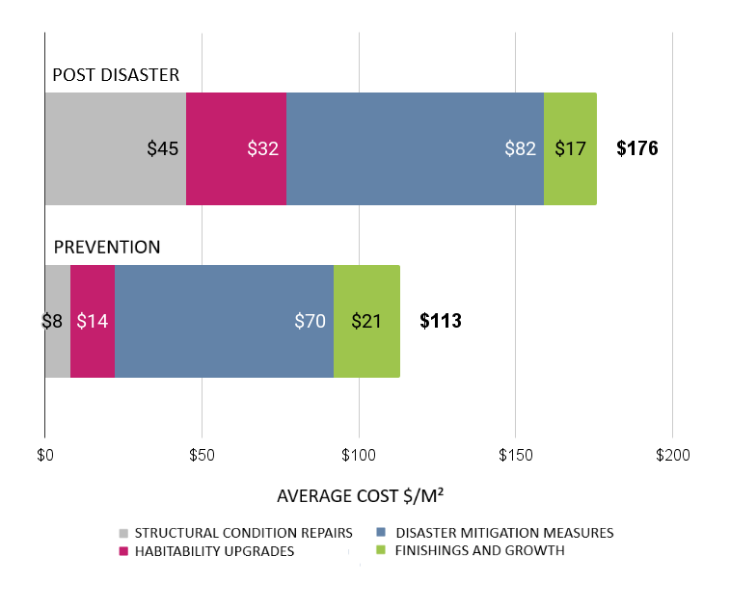
Improving housing before—rather than after—a disaster, is a smarter, more cost-effective investment.
TABLE 4 Dataset by Region and Context
LOCATION | NO. OF DESIGN GROUPS
 | POST DISASTER | PREVENTION
ASIA | 6 | 12
CARIBBEAN | 11 | 0
LATIN AMERICA | 6 | 19
PACIFIC ISLANDS | 0 | 21
TOTAL | 23 | 52
Investments in improving existing housing before a disaster are more cost efficient and enable more of the investment to be directed toward non-structural and forward-looking interventions, rather than repairs.
FIGURE 7 Cost Comparison for Post-Disaster and Prevention Contexts
19
Notes:
Figure 7 shows the average total cost of improvements for the Post-Disaster design groups was $176/m², whereas for the Prevention design groups this was only $113/m².
With the exception of Finishings and growth, costs increased in every category in the Post-Disaster context, with the cost of Structural condition repairs increasing by 5.9 times ($8/m² for Prevention and $45/m² for Post Disaster).
It should be noted that the cost increases observed across almost all categories in the Post-Disaster context are likely to also reflect the rise in labor wage rates, material prices, equipment costs and contractor profit that can result from demand surge following disasters.
For a post-hurricane housing recovery project in Sint Maarten, an average added investment of 30% helped to ensure the entire house was more disaster resistant, instead of only repairing the severely damaged roofs.

Slide 20
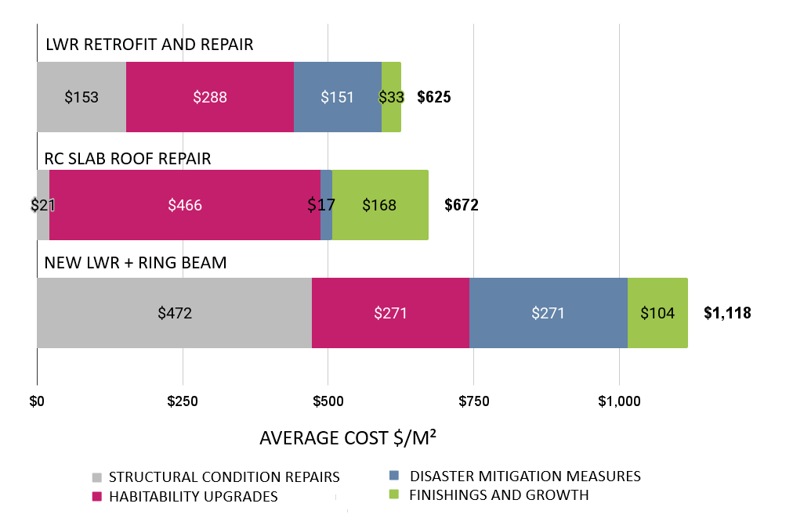
Improving housing before—rather than after—a disaster, is a smarter, more cost-effective investment.
Figure 8 Average Costs by Roof Intervention Type, for Life-Safety Performance Target (Sint Maarten)
In post-disaster settings, investments should go beyond repairing damage, to make preventative home improvements that will protect the investment against future threats, for a low additional cost.
20
Notes:
Lightweight roof (LWR) retrofit and repair: For houses with a lightweight roof made of timber or steel framing in which the roof was repaired and strengthened. These had a lower level of damage to the existing elements.
New LWR + ring beam: For houses with a lightweight roof made of timber or steel framing in which the entire roof was replaced. These had a high level of damage to the existing elements, including badly deteriorated reinforced concrete roofs which were replaced with a new lightweight roof.
Reinforced concrete (RC) slab roof repair: For houses with a reinforced concrete slab roof in which the roof was repaired. These had a lower level of damage and deterioration.
Overall, when the roof could be repaired, the total cost of improving the house was about 40% lower (average of $625 and $672, for repair of LWR and RC slabs, respectively) than the average total cost for houses requiring roof replacement ($1,118). This further highlights that preventing damage—both by ensuring the structure can withstand the applicable loads and by starting with quality construction materials and practices—ultimately saves money in the next disaster by avoiding having to replace and rebuild structures.
For the new LWR + ring beam interventions, the roof reconstruction is categorized as Structural condition repair, as this work addresses the high level of damage to the roof. In these cases, the cost of additional disaster-mitigation measures is only 24% of the total cost of all improvement work, or an additional investment of approximately 30% . This additional cost is low considering such work can help mitigate against other threats, like earthquakes, and better protect the investment in the new roof and all other work undertaken to increase the building’s resilience against future windstorms.
For a post-hurricane housing recovery project in Sint Maarten, an average added investment of 30% helped to ensure the entire house was more disaster resistant, instead of only repairing the severely damaged roofs.

Slide 21
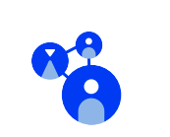





OUR IMPACT
1.1M+ people made safer
1.5M+ mt of emissions avoided
Over 70 policies influenced
Systems
Change
Safety,
Resilience,
& Health
Climate Sustainability
40K+
Jobs
Created
2.2M+ people reached
28K+ women trained
Economic Prosperity
Knowledge Dissemination
Gender
Equity

Slide 22
Juan Caballero
juan@buildchange.org

