Slide 1








Housing Improvement: the experience of National Public Policies in Brazil
Amanda Olalquiaga
Deputy Director for Social Housing Production – Ministry of Cities Brazil
Incremental housing as an opportunity to build green and resilient communities, the experience of Latin America and the Caribbean
Public policies and regulatory frameworks for upgrading progressive housing

Slide 2




Housing needs
in Brazil
SLUMS AND HOUSING INADEQUACY
HOUSING DEFICIT
INADEQUATE INFRASTRUCTURE
INADEQUATE LAND TENURE
STRUCTURAL INADEQUACIES
COHABITATION
PRECARIOUS HOUSING
EXCESSIVE RENT BURDEN
URBANIZATION OF INFORMAL
SETTLEMENTS
LAND TENURE REGULARIZATION
HOUSING IMPROVEMENT
SUBSIDIZED PROVISION
SOCIAL RENT
FINANCED PROVISION
15,5 million
3,2 million
12,3 million
1,3 million
1,7 million
3,2 million
Source: Basic data: Brazilian Institute of Geography and Statistics (IBGE), Continuous National Household Sample Survey ( PnadC) - 2022
Calculated by the João Pinheiro Foundation (FJP)

Slide 3

Inadequate housing
in Brazil
LAND TENURE
10%
4x
THE HOUSING DEFICIT
26
MILLION
URBAN HOUSEHOLDS
INADEQUATE INFRASTRUCTURE 50%
STRUCTURAL INADEQUACIES
40%
41%
OF URBAN
HOUSEHOLDS
85%
OF BRAZILIANS SELF-BUILT THEIR HOMES WITHOUT TECHNICAL ASSISTANCE
Source: Datafolha survey, at the service of CAU/BR, 2015
Source: Basic data: Brazilian Institute of Geography and Statistics (IBGE), Continuous National Household Sample Survey ( PnadC) - 2022
Calculated by the João Pinheiro Foundation (FJP)

Slide 4

Structural inadequacies
91,7% are HOUSES
in Brazil
64,8% OWN their homes, 23,8% are rented
12,3
MILLION URBAN HOUSEHOLDS
Water storage sub-indicators
Rooms serving as bedrooms
No bathroom for exclusive use
Inadequate roofing
Inadequate flooring
48,9% have monthly family income
up to US$ 492 (2 minimum wages)
54,5% are WOMEN-HEADED
households
23% | 26% | 18% | 33%
61% the head of the household is a
BLACK person
Up to 1 Minimum
Wage
From 1 to 2
Minimum Wages
From 2 to 3
Minimum W
Above 3 Minimum Wages
Source: Basic data: Brazilian Institute of Geography and Statistics (IBGE), Continuous National Household Sample Survey ( PnadC) - 2022
Calculated by the João Pinheiro Foundation (FJP)

Slide 5
Previous experiences
CAIXA
ProMORAR BRASIL IDB
CONSTRUCARD
MCIDADES
Individual credit for
construction materials
and labor
PROGRAMA DE REGULARIZAÇÃO FUNDIÁRIA E MELHORIAS HABITACIONAIS
MINHA CASA MINHA VIDA
CONCIDADES
FGTS
Housing improvement as a new component – Micro finance
CARTA DE CRÉDITO IND.
FGTS
HBB
SNHIS
PAC UAP
FIMAC
PERIFERIA VIVA
Subsidies for local governments as a component of Slum Upgrading
Individual credit for middle income families
Subsidies for housing improvement and land tenure reg.
Individual credit for conclusion and improvement
1995 1996 1998
Component of Slum Upgrading
FNHIS
Subsidies for housing improvement and land tenure regularization
2001
2003
2005
2007 2008 2009
2012
2017 2018 2019 2020 2021
2023
ESTATUTO DA CIDADE
Lei 10.257/2001
CARTÃO
REFORMA
NOVO PAC
MINHA CASA MINHA
UAP - Housing Improvement as a component of Slum Upgrading – subsidies for local governments
Subsidies for rural housing improvement
PRÓ-MORADIA
FGTS/CAIXA
Credit for local governments as a component of Slum Upgrading
CARTA DE CRÉDITO IND./ CONSTRUCARD
FNHIS 2007-2011
FNHIS - Subsidized Housing Improvement in contracts with local governments and civil society organizations
Subsidized Technical Assistance in contracts with local governments and civil society organizations
PROGRAMA MORADIA DIGNA
Individual credit for
conclusion, improvement
_{FGTS} and construction materials
CRED-MAC
Individual credit for
construction materials

Slide 6







Housing policy innovations
Resumption of the Minha Casa, Minha Vida with the inclusion of housing improvement as a program component
HOUSING PROVISION
HOUSING IMPROVEMENT
GROUP 1
SUBSIDIZED PROVISION
SUBSIDIZED FINANCED PROVISION
GROUP 1
SUBSIDIZED HOUSING IMPROVEMENT
FINANCED HOUSING
IMPROVEMENT
GROUP 2
GROUP 2
GROUP 3
AFFORDABLE FINANCED PROVISION
GROUP 3
SBPE – LOAN SYSTEM
HOUSING MARKET - CAIXA

Slide 7





Subsidized Housing Improvement
Consolidated informal urban settlements, capable of regularization, predominately occupied by families with a monthly income of up to US$ 1.260 (5 MW)
Housing Improvement
Up to 20% of the families living in the settlements, with income up to US$ 492 (2 MW)
Housing kits with different compositions with cost of up to US$ 6.250
Bathroom construction or improvement
New room (bedroom)
Roofing
Sanitation solution
Electrical and hydraulic installations, finishings, doors/windows and flooring
Accessibility Risk prevention – drainage, structural reinforcement and floodgate
Land Tenure Regularization 100% of the families living in the settlement
Executed by private entities responsible for developing projects and providing technical assistance
Regularization kit of US$ 300

Slide 8
Subsidized Housing Improvement
MINISTRY OF CITIES
CAIXA – NATIONAL PUBLIC HOUSING BANK
PROMOTOR AGENTS
LOCAL GOVERNMENTS
FINANCING INSTITUTIONS
FAMILIES
Assess and contract proposals
Agree to the subsidized financing contract
Regulation
Operate funding
Develop projects and submit proposals
Join the program
Funding
Accredit financing institutions
Construction work
Classify settlements and consent to proposals
Monitor construction work and services
Pay back 1% of the value of the investment
Select proposals
Controle
Mobilize families and support with social work and technical assistance
Approve interventions once finished
Monitor and evaluate
Operational procedures
Approve projects
Manage funding

Slide 9
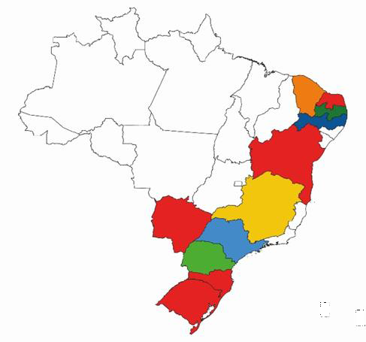
Subsidized Housing Improvement
Results
Innovations based on experience
 | Proposals | Cities | Investments | Families Land Reg. | Families Housing Imp.
Selected | 245 | 162 | US$ 74 mi | 101.171 | 20.234
Approved | 164 | 132 | US$ 51 | 69.061 | 13.825
To be contracted | 91 | 82 | US$ 28 | 26.733 | 7.547
Dissociate housing improvement from land tenure regularization
New and diversified housing kits based on practice:
  Expand solutions offered for the same type of inadequacy
  Inclusion of climate adaptation kits
Accept as promoter civil society organizations - non-profit organizations and social movements
Anticipation of funding for interventions by non-profit organizations licensed by the Ministry of Cities
Challenges
Expansion of the accredited network - concentrated without national coverage

Slide 10


Microfinance for Housing Improvement
Guarantee minimum adequate housing conditions by means of housing improvement or expansion, improving the life quality and health of families, resilience and safeness
Premises
Access to microfinance with accessible interest rates: Families with monthly income up to US$ 1.428 (MCMV Group 3)
Technical Assistance:
Project development
Execution and monitoring of construction work
Technical Assistance mandatory: Ensuring the quality of interventions and aiding in the program's purpose control
Engagement of local governments: Definition of intervention areas aligned to the program's purposes
Intervention areas:
Regularized/consolidated settlements
Regularizable settlements
Historical heritage
Degraded social housing stock
Easy and agile monitoring: APP/digital platform for field purpose control based on intervention types, climate impact assessment and data systematization

Slide 11
Microfinance for Housing Improvement
Lessons learnt from partners and previous experiences
MICROFINANCE
Small incremental loans
Customized methodology for credit analysis
Diversity of credit agents/financial institutions
Proximity between credit agent and beneficiary family, minimizing default rates
TECHNICAL ASSISTANCE
Use of digital tools for agile verification of application of public resources
Quality standard control: technical assistance throughout the whole process
Specific assistance depending on region, disaster situations, tackling climate change
Identify priority areas for action and priority beneficiary families
LOCAL GOVERNMENTS

Slide 12


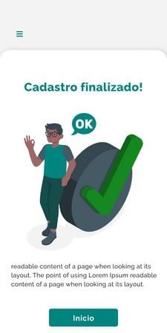
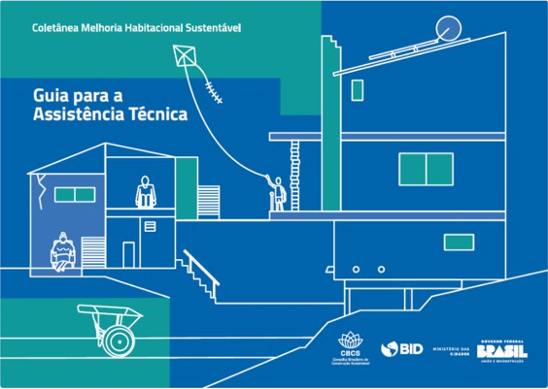

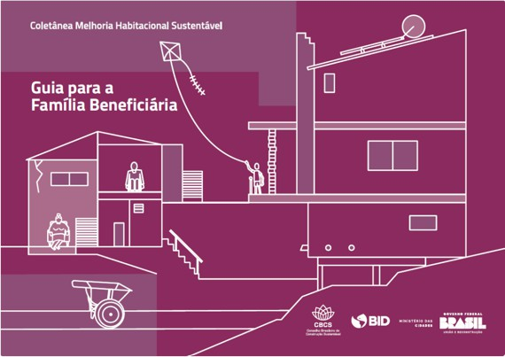
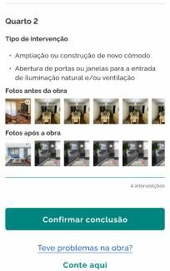
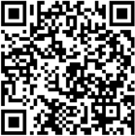
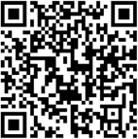
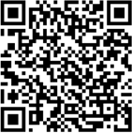
Microfinance for Housing Improvement
Pro-Morar Brasil – IDB Loan and Technical Cooperation
FIRST LOSS GUARANTEE
Create a sustainable market for housing improvement, mobilizing public and private fundings
APP FOR PURPOSE CONTROL, CLIMATE IMPACT ASSESSMENT AND DATA SYSTEMATIZATION
GUIDANCE AND CAPACITY BILDING FOR PROFESSIONALS, WORKERS AND FAMILIES
Guide for Technical Assistance
Guide for Construction Workers
Guide for Beneficiary Family

Slide 13

THANK YOU!
www.cidades.gov.br dpsm@cidades.gov.br amanda.olalquiaga@cidades.gov.br

